Slide 1
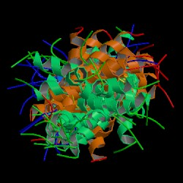
Protein Structure, Databases and Structural Alignment

Slide 2
Basics of protein structure

Slide 3
Why Proteins Structure ?
Proteins are fundamental components of all living cells, performing a variety of biological tasks.
Each protein has a particular 3D structure that determines its function.
Protein structure is more conserved than protein sequence, and more closely related to function.

Slide 4
Protein Structure
Protein core - usually conserved.
Protein loops - variable regions
Surface loops
Hydrophobic core

Slide 5
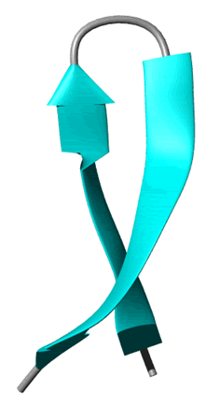
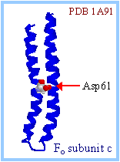
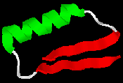
Supersecondary structures
Assembly of secondary structures which are shared by many structures.
Beta-alpha-beta unit
Beta hairpin
Helix hairpin

Slide 6
Principles of Protein Structure
Today's proteins reflect millions of years of evolution.
3D structure is better conserved than sequence during evolution.
Similarities among sequences or among structures may reveal information about shared biological functions of a protein family.

Slide 7
The Levinthal paradox
Assume a protein is comprised of 100 AAs and that each AA can take up 10 different conformations. Altogether we get:10¹⁰⁰ (i.e. google) conformations.
If each conformation were sampled in the shortest possible time (time of a molecular vibration ~ 10⁻¹³ s) it would take an astronomical amount of time (~1077 years) to sample all possible conformations, in order to find the Native State.

Slide 8
The Levinthal paradox
Luckily, nature works out with these sorts of numbers and the correct conformation of a protein is reached within seconds.

Slide 9
How is the 3D Structure Determined ?
Experimental methods (Best approach):
X-rays crystallography.
NMR.
Others (e.g., neutron diffraction).

Slide 10
How is the 3D Structure Determined ?
In-silico methods
Ab-initio structure prediction given only the sequence as input - not always successful.

Slide 11

A note on ab-initio predictions: The current state is that “failure can no longer be guaranteed”…

Slide 12
How is the 3D Structure Determined ?
In-silico methods
Threading = Sequence-structure alignment. The idea is to search for a structure and sequence in existing databases of 3D structure, and use similarity of sequences + information on the structures to find best predicted structures.

Slide 13
Comments
X-ray crystallography is the most widely used method.
Quaternary structure of large proteins (ribosomes, virus particles, etc) can be determined by electron microscopes (cryoEM).

Slide 14
Protein Databases

Slide 15
PDB: Protein Data Bank
Holds 3D models of biological macromolecules (protein, RNA, DNA).
All data are available to the public.
Obtained by X-Ray crystallography (84%) or NMR spectroscopy (16%).
Submitted by biologists and biochemists from around the world.

Slide 16
PDB: Protein Data Bank
Founded in 1971 by Brookhaven National Laboratory, New York.
Currently it holds > 94,873 structures.

Slide 17
PDB - model
A model defines the 3D positions of atoms
There are models of proteins, protein complexes, proteins and DNA, protein segments, etc …
The models also include the positions of ligand molecules, solvent molecules, metal ions, etc.

Slide 18
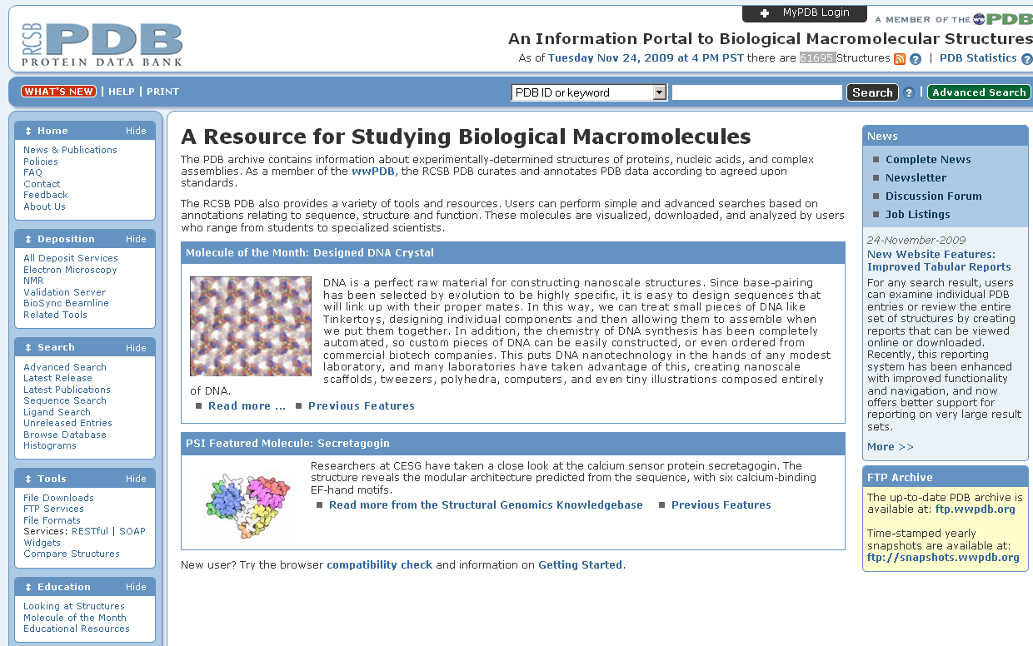
PDB – Protein Data Bank
http://www.pdb.org/pdb/home/home.do

Slide 19
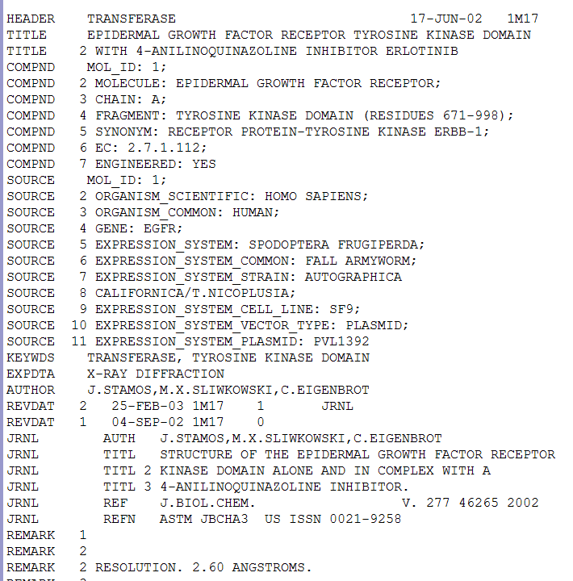
The PDB file – text format

Slide 20
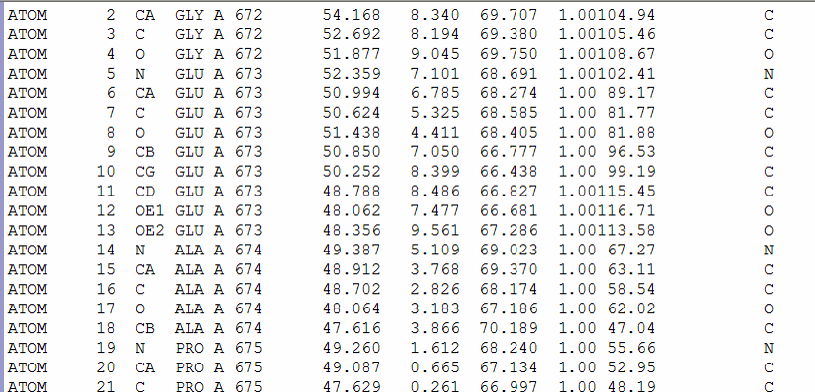
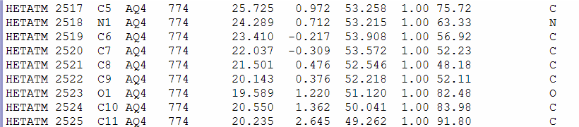
The PDB file – text format
Residue identity
The coordinates for each residue in the structure
Atom identity
chain
Atom number
Residue number
X
Y
Z
ATOM:
Usually protein or DNA
HETATM:
Usually Ligand, ion, water

Slide 21
Structural Alignment

Slide 22
Why structural alignment?
Structural similarity can point to remote evolutionary relationship
Shared structural motifs among proteins suggest similar biological function
Getting insight into sequence-structure mapping (e.g., which parts of the protein structure are conserved among related organisms).

Slide 23
As in any alignment problem, we can search for GLOBAL ALIGNMENT or for LOCAL ALIGNMENT

Slide 24
Human Myoglobin pdb:2mm1
Human Hemoglobin alpha-chain pdb:1jebA
Sequence id: 27%
Structural id: 90%

Slide 25
What is the best transformation that
superimposes the unicorn on the lion?

Slide 26
Solution:
Regard the shapes as sets of points
and try to “match”
these sets using a transformation

Slide 27
This is not a good result….

Slide 28
Good result:

Slide 29
Kinds of transformations:
Rotation
Translation
Scaling
and more….

Slide 30
Translation:
Y
X

Slide 31
Rotation:
Y
X

Slide 32
Scale:
Y
X

Slide 33
We represent a protein as a geometric object in the plane.
The object consists of points represented by coordinates (x, y, z).
Lys
Met
Gly
Thr
Glu
Ala

Slide 34
The aim:
Given two proteins
Find the transformation that produces the best Superimposition of one protein onto the other

Slide 35
Correspondence is Unknown
Given two configurations of points in the three dimensional space:
+

Slide 36
Find those rotations and translations of one of the point sets which produce “large” superimpositions of corresponding 3-D points
?

Slide 37
The best transformation:
T

Slide 38
Simple case – two closely related proteins with the same number of amino acids.
+
Question:
how do we asses the quality of the transformation?

Slide 39
Scoring the Alignment
Two point sets: A={a_{i}} i=1…n
B={b_{j}} j=1…m
Pairwise Correspondence:
(a_{k1},b_{t1}) (a_{k2},b_{t2})… (a_{kN},b_{tN})
(1) Bottleneck max ||a_{ki} – b_{ti}||
(2) RMSD (Root Mean Square Distance)
Sqrt( Σ||a_{ki} – b_{ti}||²/N)

Slide 40
RMSD – Root Mean Square Deviation
Given two sets of 3-D points :
P={p_{i}}, Q={q_{i}} , i=1,…,n;
rmsd(P,Q) = √ Σ _{i}|p_{i} - q_{i} |² /n
Find a 3-D transformation T* such that:
rmsd( T*(P), Q ) = min_{T} √ Σ _{i}|T(p_{i}) - q_{i} |² /n
Find the highest number of atoms aligned with the lowest RMSD

Slide 41
Pitfalls of RMSD
all atoms are treated equally
(residues on the surface have a higher degree of freedom than those in the core)
best alignment does not always mean minimal RMSD
does not take into account the attributes of the amino acids
Notes:
Atoms on the surface have a higher degree of freedom than those in the core

Slide 42
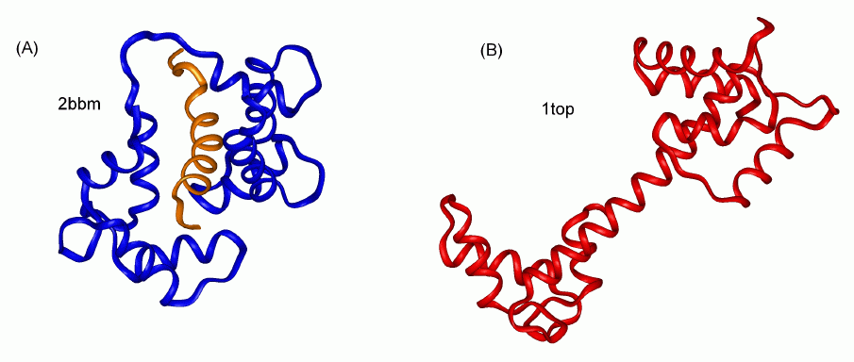
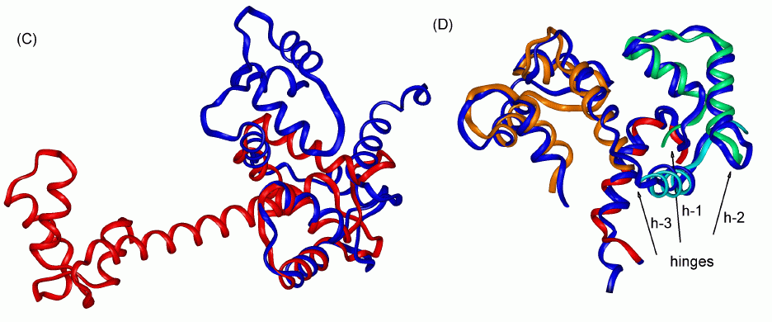
Flexible alignment vs. Rigid alignment
Flexible alignment
Rigid alignment

Slide 43
Some more issues

Slide 44
Does the fact that all proteins have alpha-helix indicates that they are all evolutionary related?
No. Alpha helices reflect physical constraints, as do beta sheets.
For structures – it is difficult sometimes to separate convergent evolution from evolutionary relatedness.

Slide 45
Structural genomics: solve or predict 3D of all proteins of a given organism (X-ray, NMR, and homology modelling).
Unlike traditional structural biology, 3D is often solved before anything is known on the protein in question. A new challenge emerged: predict a protein’s function from its 3D structure.

Slide 46
CASP: a competition for predicting 3D structures.
Instead of running to publish a new 3D structure, the AA sequence is published and each group is invited to give their predictions.

Slide 47
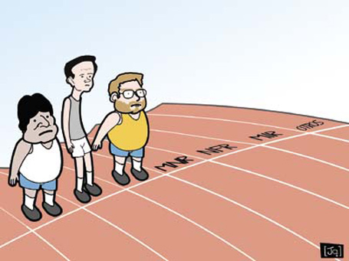
Capri: same as casp – but for docking.

Slide 48
Homology modeling: predicting the structure from a closely related known structure.
This can be important for example to predict how a mutation influences the structure

