Slide 1
Protein structure primer

Slide 2
The levels of protein structure
Primary Structure: the amino acid sequence of a protein.
(ii) Secondary Structure:
α-helix
β-sheet consists of two or more β-strands
connected by hydrogen bonds.

Slide 3
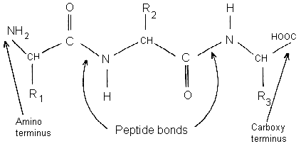
Amino acids in proteins (or polypeptides) are joined
together by peptide bonds.

Slide 4
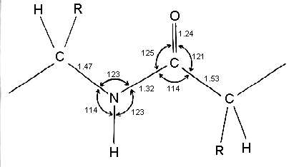
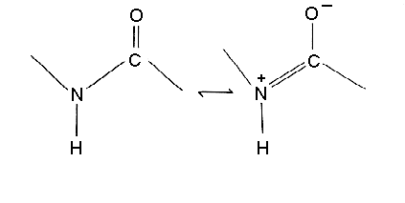
Linus Pauling and Robert Corey
Note that the C-N bond length of the peptide is 10% shorter than that found in usual C-N amine bonds. This is because the peptide bond has some double bond character (40%) due to resonance which occurs with amides. The two canonical structures are:
Distances in Angstroms.
1 A = 1.0 × 10⁻¹⁰ meters
=0.1 nm

Slide 5
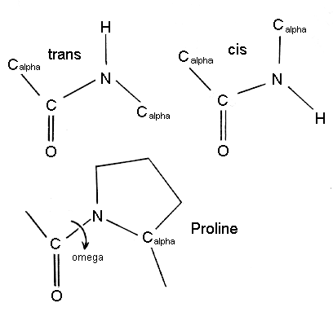
Co-planarity
As a consequence of this resonance all peptide bonds in protein structures are found to be almost planar, ie atoms Calpha(i), C(i), O(i), N(i+1) H(i+1) and Calpha(i+1) are approximately co-planar. This rigidity of the peptide bond reduces the degrees of freedom of the polypeptide during folding.

Slide 6
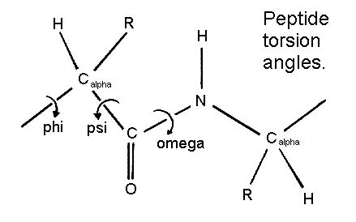
Peptide torsion angles
The planarity of the peptide bond restricts omega to 180 degrees in very nearly all of the main chain peptide bonds. In rare cases omega = 0 degrees for a cis peptide bond which, as stated above, usually involves proline.

Slide 7
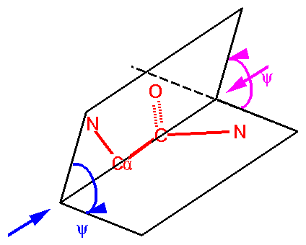

Slide 8
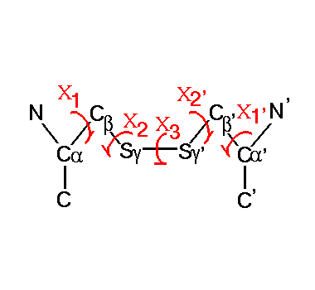
Disulphide Bond

Slide 9
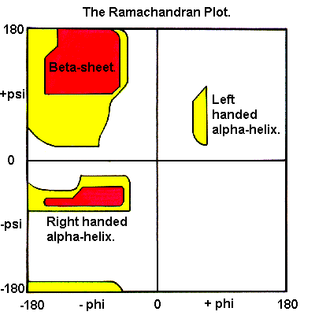
The Ramachandran Plot
The main chain N-Calpha and Calpha-C bonds relatively are free to rotate: torsion angles phi and psi.
Red: no clashes
Yellow: close positions
White: very unfavourable

Slide 10
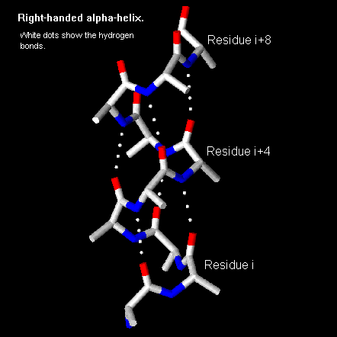
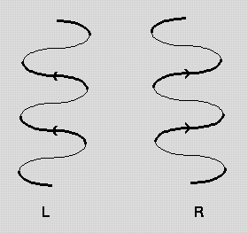
Alpha-Helix Structure

Slide 11
Properties of the alpha-helix
The structure repeats itself every 5.4 Angstroms along the helix axis, ie we say that the alpha-helix has a pitch of 5.4 Angstroms. Alpha-helices have 3.6 amino acid residues per turn, ie a helix 36 amino acids long would form 10 turns. The separation of residues along the helix axis is 5.4/3.6 or 1.5 Angstroms, ie the alpha-helix has a rise per residue of 1.5 Angstroms.
Every mainchain C=O and N-H group is hydrogen-bonded to a peptide bond 4 residues away (ie O(i) to N(i+4)). This gives a very regular, stable arrangement.

Slide 12
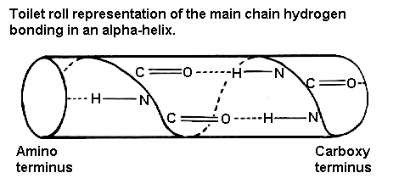
The peptide planes are roughly parallel with the helix axis and the dipoles within the helix are aligned, ie all C=O groups point in the same direction and all N-H groups point the other way. Side chains point outward from helix axis and are generally oriented towards its amino-terminal end.
All the amino acids have negative phi and psi angles, typical values being -60 degrees and -50 degrees, respectively.

Slide 13
Folding prediction by HMM’s
In silico complete 3D structure prediction is a black magic, seldom gives good results.
There is a higher success rate for folding (i.e., secondary structure) prediction.
Pfam uses HMM based multiple sequence alignment (NP hard); Pfam contains more than 2000 folds,

Slide 14
For each of them a profile HMM has been
estimated from a family of proteins containing the fold.
A query sequence is run past each of these HMMs.
If a part of the sequence has probability greater than a certain cutoff for a particular HMM, the corresponding domain is reported in the sequence.

Slide 15
Theading: Environmental template method 1
Sequence-to-sequence alignment, BLOSUM matrix, problem: representation
One aligns a sequence to a string of descriptors that describe the environment of each residue in the structure S.
B1 (buried, hydrophobic),
B2 (buried, moderately polar),
B3 (buried, polar),
P1 (partially bur., mod. polar),
P2 (partially buried, polar),
E (exposed).

Slide 16
Environmental template method 2
S is the sequence, categorized into
α (for α-helices),
β (for β-sheets)
γ (for all other secondary structures).
One can now convert the known structure S into a string: S = e1, . . . , en, where ej are elements of C.
p_{ae} is the frequency of the occurrence of the amino acid a in the environment
e in the database;
p_{a} is the frequency of the occurrence of a anywhere in
the database

Slide 17


Slide 18
Gaps are allowed,
Gap penalties need to be fixed well,
Smith-Waterman or BLAST variants
Usually better results than sequence-to-sequence alignment

Slide 19
Ab initio modelling
Energy potential functions
Simplified approach: not quantum-physics or chemistry, simplified energy potentials.
Energy functions take into account all atoms in a protein molecule. Since the number of amino acids in proteins ranges from 25 to 3000 and the number of atoms ranges from around 500 to more than 10000, dealing even with the simplest energy functions may be a difficult computational task.
1000 choose 2 is around 500 000.

Slide 20
Some energy potential functions
Bonded and non-bonded
interactions
Spring model
In classical mechanics, a harmonic oscillator is a system which, when displaced from its equilibrium position, experiences a restoring force, F, proportional to the displacement, x according to Hooke's law: F=kx. Energy: ½ kx²

Slide 21
Dihedral energy

Slide 23
What next? The optimization
It is difficult.
If the functions were linear…
Local optimization
Global optimization

Slide 24
Alternatives: simplified models
The HP-lattice
Hydrofobic-polar lattice
method

