Slide 1
The first microbial genome sequenced, that of the pathogen Haemophilus influenzae, was published in 1995 (Fleischmann et al. 1995). Microbial genome sequences have since appeared at an exponentially increasing rate: the genome sequences of 399 bacteria, 29 archaea, and almost 30 eukaryotic microbes are publicly available in 2007.
the genomes of humans differ from one another by only 0.1%.
the genomes of bacteria in (supposedly) the same species may differ in 30% in the proteins they encode

Slide 2
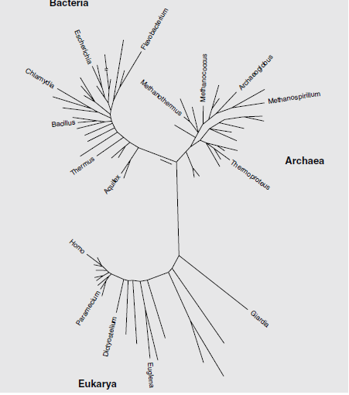
Tree of life – phylogenomics tree
Made by comparisons of
ribosomal RNA, rRNA
sequences
Numerous problems...

Slide 3
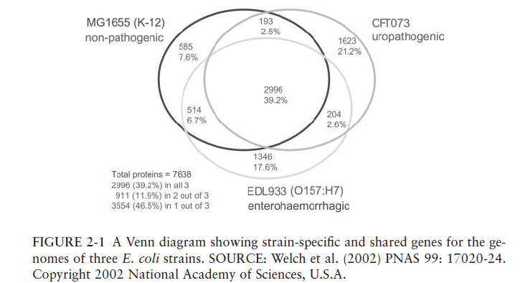
Diversity of E. coli strains

Slide 4
Names carry important legal and regulatory implications.
“Bacillus cereus group,” which contains B. cereus, B. thuringiensis, and B. anthracis (Priest et al. 2004).
The first species in the group contains strains that induce food poisoning, strains that prevent plant disease, and others that produce unusual antibiotics. Some B. cereus strains can perform more than one of these activities.
B. thuringiensis is the most widely used bioinsecticide in the world; it produces crystal proteins that are toxic to certain insect pests. Some B. thuringiensis strains also produce the toxins associated with food poisoning in humans caused by B. cereus, but this was not recognized when B. thuringiensis was first registered for use in 1961.
B. anthracis is the causal agent of anthrax, a disease deadly to both cattle and people. Modern phylogeny and genomics indicate that the three species probably make up a single species with a few dramatic phenotypic differences due to a small number of genes.

Slide 5
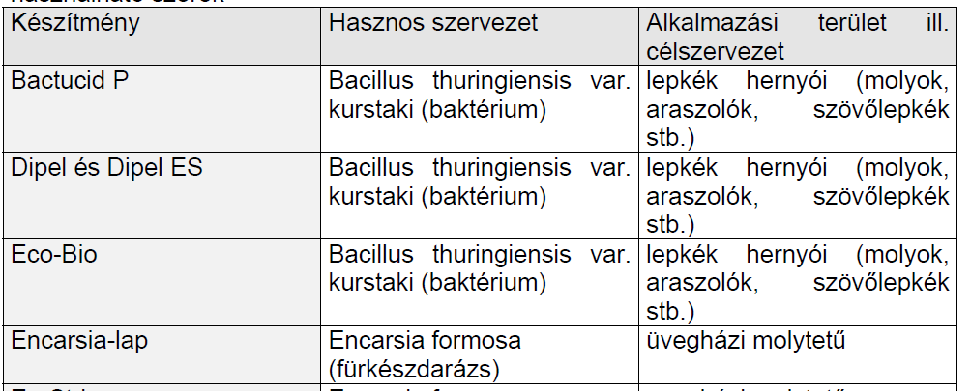

Slide 6
We might simply modify Leroy Hood’s definition of systems biology as “the science of discovering, modeling, understanding and ultimately managing at the molecular level the dynamic relationships between the molecules that define living organisms” (Hood 2006).
We need only replace the last word, organisms, with the
phrase “communities and the biosphere.”
First I, personally, did not like this sentence. I believed that it simply
pushes the problems of biology to a level where they cannot be
manageable.
Perhaps it is true in part, but: the techniques are capable to identify
genes in the environmental sample, and we do not know the identity of
the species that produce that gene!
That is the meaning of this sentence, and: this is the beginning of the end
of the species concept.

Slide 7
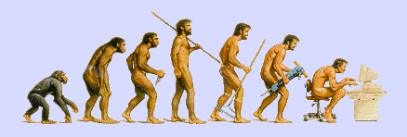
Phylogenetic Trees Lecture 1
Credits: N. Friedman, D. Geiger , S. Moran,

Slide 8
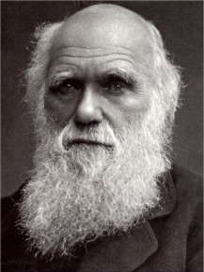
Evolution
Evolution of new organisms is driven by
Diversity
Different individuals carry different variants of the same basic blue print
Mutations
The DNA sequence can be changed due to single base changes, deletion/insertion of DNA segments, etc.
Selection bias

Slide 9
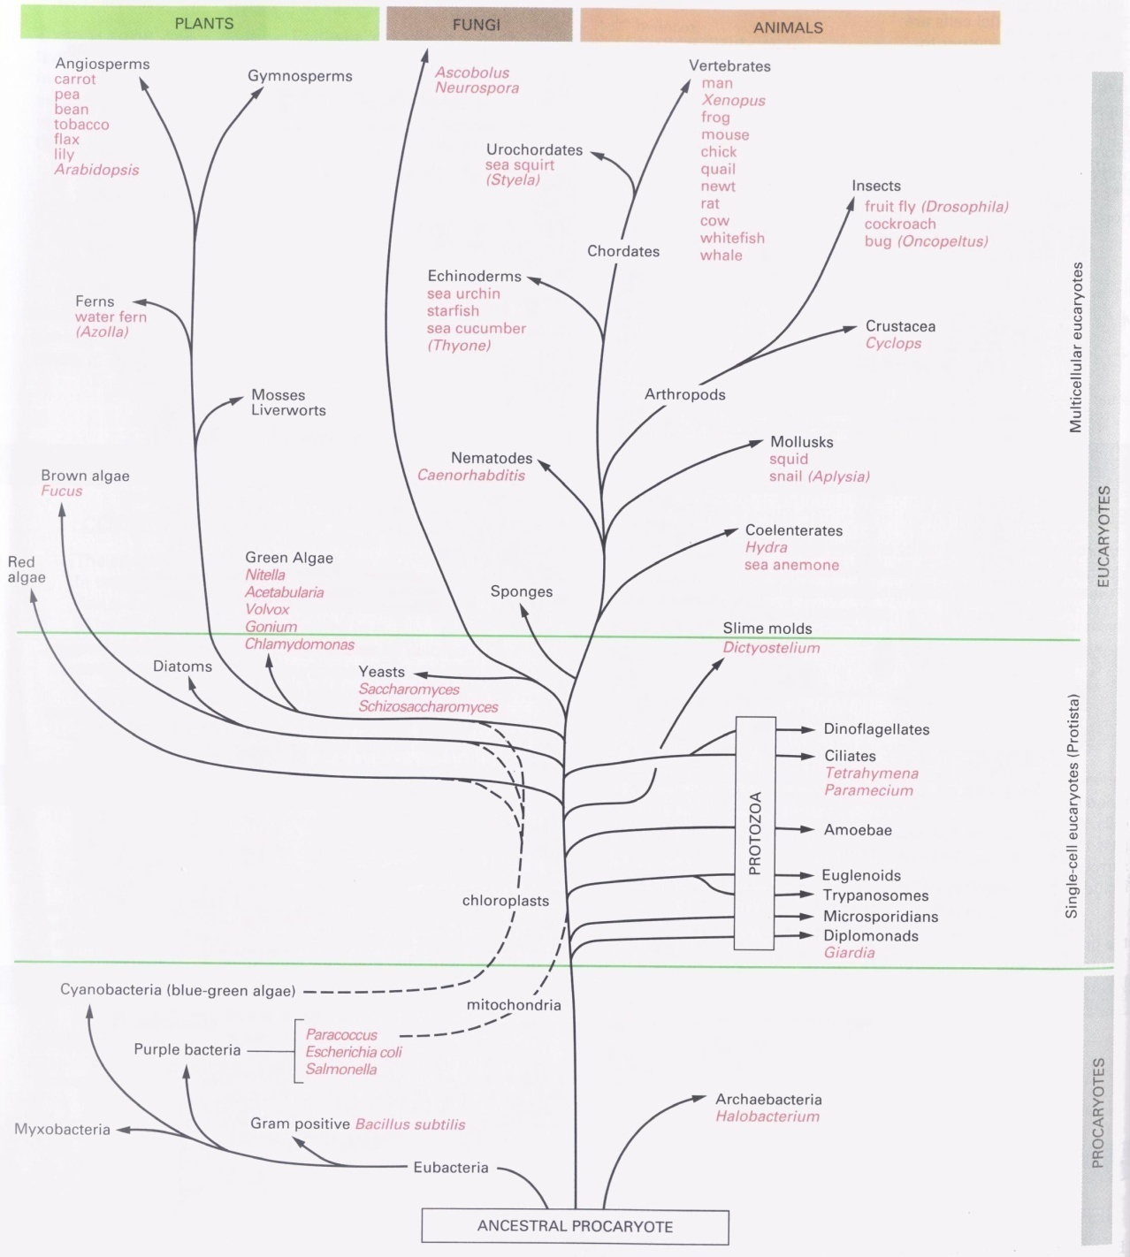
The Tree of Life
Source: Alberts et al

Slide 10
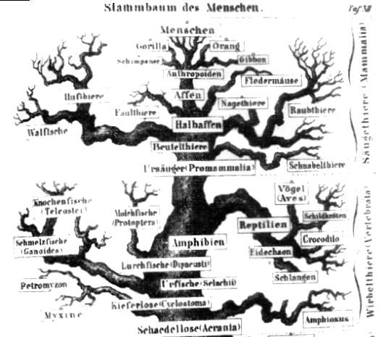
Tree of life- a better picture
D’après Ernst Haeckel, 1891

Slide 11
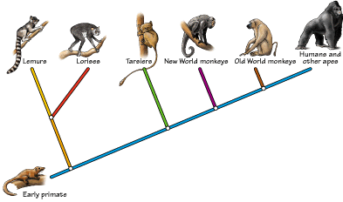
Primate evolution
A phylogeny is a tree that describes the sequence of speciation events that lead to the forming of a set of current day species; also called a phylogenetic tree.

Slide 12
Historical Note
Until mid 1950’s phylogenies were constructed by experts based on their opinion (subjective criteria)
Since then, focus on objective criteria for constructing phylogenetic trees
Thousands of articles in the last decades
Important for many aspects of biology
Classification
Understanding biological mechanisms

Slide 13
Morphological vs. Molecular
Classical phylogenetic analysis: morphological features: number of legs, lengths of legs, etc.
Modern biological methods allow to use molecular features
Gene sequences
Protein sequences
Analysis based on homologous sequences (e.g., globins) in different species

Slide 14
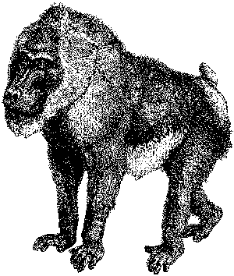

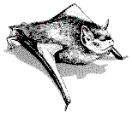
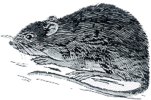
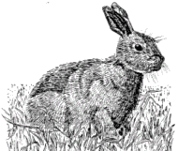
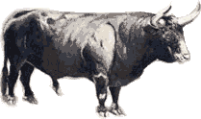
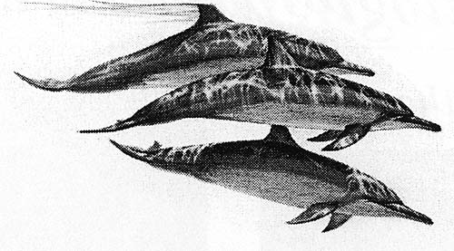
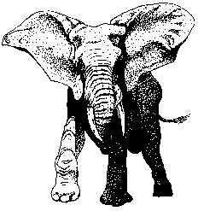
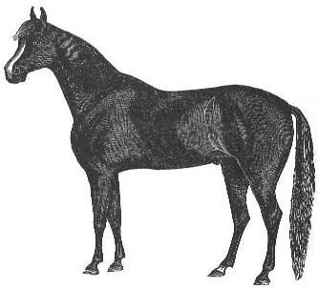
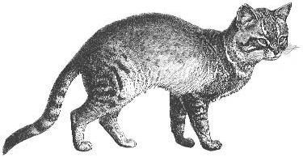



Morphological topology
(Based on Mc Kenna and Bell, 1997)
Bonobo
Chimpanzee
Man
Gorilla
Sumatran orangutan
Bornean orangutan
Common gibbon
Barbary ape
Baboon
Archonta
White-fronted capuchin
Slow loris
Tree shrew
Japanese pipistrelle
Long-tailed bat
Jamaican fruit-eating bat
Horseshoe bat
Little red flying fox
Ryukyu flying fox
Mouse
Rat
Glires
Vole
Cane-rat
Guinea pig
Squirrel
Dormouse
Rabbit
Pika
Pig
Hippopotamus
Sheep
Ungulata
Cow
Alpaca
Blue whale
Fin whale
Sperm whale
Donkey
Horse
Indian rhino
White rhino
Elephant
Carnivora
Aardvark
Grey seal
Harbor seal
Dog
Cat
Asiatic shrew
Insectivora
Long-clawed shrew
Small Madagascar hedgehog
Hedgehog
Gymnure
Mole
Armadillo
Xenarthra
Bandicoot
Wallaroo
Opossum
Platypus

Slide 15
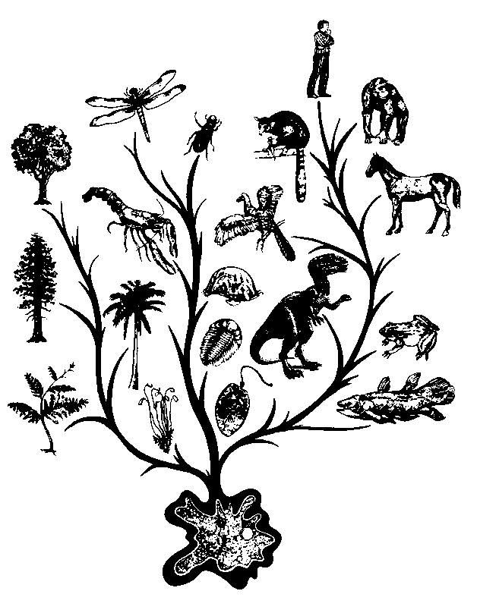
From sequences to a phylogenetic tree
Rat QEPGGLVVPPTDA
Rabbit QEPGGMVVPPTDA
Gorilla QEPGGLVVPPTDA
Cat REPGGLVVPPTEG
There are many possible types of sequences to use (e.g. Mitochondrial vs Nuclear proteins).

Slide 16
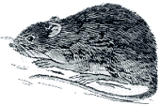
Mitochondrial topology
(Based on Pupko et al.,)
Perissodactyla
Donkey
Horse
Carnivora
Indian rhino
White rhino
Grey seal
Harbor seal
Dog
Cetartiodactyla
Cat
Blue whale
Fin whale
Sperm whale
Hippopotamus
Sheep
Cow
Chiroptera
Alpaca
Pig
Little red flying fox
Ryukyu flying fox
Moles+Shrews
Horseshoe bat
Japanese pipistrelle
Long-tailed bat
Afrotheria
Jamaican fruit-eating bat
Asiatic shrew
Long-clawed shrew
Mole
Small Madagascar hedgehog
Xenarthra
Aardvark
Elephant
Armadillo
Rabbit
Lagomorpha
+ Scandentia
Pika
Tree shrew
Bonobo
Chimpanzee
Man
Gorilla
Sumatran orangutan
Primates
Bornean orangutan
Common gibbon
Barbary ape
Baboon
White-fronted capuchin
Rodentia 1
Slow loris
Squirrel
Dormouse
Cane-rat
Rodentia 2
Guinea pig
Mouse
Rat
Vole
Hedgehog
Hedgehogs
Gymnure
Bandicoot
Wallaroo
Opossum
Platypus

Slide 17

Nuclear topology
(Based on Pupko et al. slide)
(tree by Madsenl)
Chiroptera
Round Eared Bat
Eulipotyphla
Flying Fox
Hedgehog
Pholidota
Mole
Pangolin
1
Whale
Hippo
Cetartiodactyla
Cow
Pig
Carnivora
Cat
Dog
Perissodactyla
Horse
Rhino
Rat
Glires
2
Capybara
Rabbit
Scandentia+
Dermoptera
Flying Lemur
3
Tree Shrew
Human
Galago
Primate
Sloth
Xenarthra
4
Hyrax
Dugong
Elephant
Afrotheria
Aardvark
Elephant Shrew
Opossum
Kangaroo

Slide 18
Theory of Evolution
Basic idea
speciation events lead to creation of different species.
Speciation caused by physical separation into groups where different genetic variants become dominant
Any two species share a (possibly distant) common ancestor

Slide 19
Basic Assumptions
Closer related organisms have more similar genomes.
Highly similar genes are homologous (have the same ancestor).
A universal ancestor exists for all life forms.
Molecular difference in homologous genes (or protein sequences) are positively correlated with evolution time.
Phylogenetic relation can be expressed by a dendrogram (a “tree”) .

Slide 20
Phylogenenetic trees
Aardvark
Bison
Chimp
Dog
Elephant
Leafs - current day species
Nodes - hypothetical most recent common ancestors
Edges length - “time” from one speciation to the next

Slide 21
Dangers in Molecular Phylogenies
We have to emphasize that gene/protein sequence can be homologous for several different reasons:
Orthologs -- sequences diverged after a speciation event
Paralogs -- sequences diverged after a duplication event
Xenologs -- sequences diverged after a horizontal transfer (e.g., by virus)

Slide 22
Gene Phylogenies
Phylogenies can be constructed to describe evolution genes.
Gene Duplication
Speciation events
1A
2A
3A
3B
2B
1B
Species Phylogeny
Three species termed 1,2,3.
Two paralog genes A and B.

Slide 23
Dangers of Paralogs
If we happen to consider genes 1A, 2B, and 3A of species 1,2,3, we get a wrong tree that does not represent the phylogeny of the host species of the given sequences because duplication does not create new species.
Gene Duplication
S
S
S
Speciation events
1A
2A
3A
3B
2B
1B
In the sequel we assume all given sequences are orthologs.

Slide 24
Types of Trees
A natural model to consider is that of rooted trees
Common
Ancestor

Slide 25
Types of trees
Unrooted tree represents the same phylogeny without the root node
Depending on the model, data from current day species does not distinguish between different placements of the root.

Slide 26
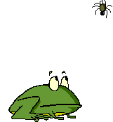
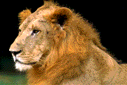
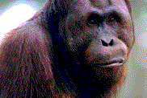
Rooted versus unrooted trees
Tree A
Tree B
Tree C
b
a
c
Represents the three rooted trees

Slide 27
Positioning Roots in Unrooted Trees
We can estimate the position of the root by introducing an outgroup:
a set of species that are definitely distant from all the species of interest
Proposed root
Falcon
Aardvark
Bison
Chimp
Dog
Elephant

Slide 28
Type of Data
Distance-based
Input is a matrix of distances between species
Can be fraction of residue they disagree on, or alignment score between them, or …
Character-based
Examine each character (e.g., residue) separately

Slide 29
Three Methods of Tree Construction
Distance- A tree that recursively combines two nodes of the smallest distance.
Parsimony – A tree with a total minimum number of character changes between nodes.
Maximum likelihood - Finding the best Bayesian network of a tree shape. The method of choice nowadays. Most known and useful software called phylip uses this method.

Slide 30
Distance-Based Method
Input: distance matrix between species
For two sequences s_{i} and s_{j} , perform a pairwise (global)
alignment. Let f = the fraction of sites with different residues. Then
Outline:
Cluster species together
Initially clusters are singletons
At each iteration combine two “closest” clusters to get a new one
(Jukes-Cantor Model)

Slide 31
Unweighted Pair Group Method using
Arithmetic Averages (UPGMA)
UPGMA is a type of Distance-Based algorithm.
Despite its formidable acronym, the method is simple and intuitively appealing.
It works by clustering the sequences, at each stage amalgamating two clusters and, at the same time, creating a new node on the tree.
Thus, the tree can be imagined as being assembled upwards, each node being added above the others, and the edge lengths being determined by the difference in the heights of the nodes at the top and bottom of an edge.

Slide 32
An example showing how UPGMA produces
a rooted phylogenetic tree

Slide 33
An example showing how UPGMA produces
a rooted phylogenetic tree

Slide 34
An example showing how UPGMA produces
a rooted phylogenetic tree

Slide 35
An example showing how UPGMA produces
a rooted phylogenetic tree

Slide 36
An example showing how UPGMA produces
a rooted phylogenetic tree

Slide 37
UPGMA Clustering
Let C_{i} and C_{j} be clusters, define distance between them to be
When we combine two clusters, C_{i} and C_{j}, to form a new cluster C_{k}, then
Define a node K and place its children nodes at depth
d(C_{i}, C_{j})/2

Slide 38
Example
UPGMA construction on five objects.
The length of an edge = its (vertical) height.
9
8
d(7,8) / 2
6
7
d(2,3) / 2
2
3
4
5
1

Slide 39
Molecular clock
This phylogenetic tree has all leaves in the same level. When this property holds, the phylogenetic tree is said to satisfy a molecular clock. Namely, the time from a speciation event to the formation of current species is identical for all paths.

Slide 40
Molecular Clock
UPGMA constructs trees that satisfy a molecular clock, even if the true tree does not satisfy a molecular clock.
3
UPGMA
2
2
3
4
1
1
4

Slide 41
Restrictive Correctness of UPGMA
Proposition: If the distance function is derived by adding edge distances in a tree T with a molecular clock, then UPGMA will reconstruct T.
Proof idea: Move a horizontal line from the bottom of the T to the top. Whenever an internal node is formed, the algorithm will create it.

Slide 42
Additivity
Molecular clock defines additive distances, namely,
distances between objects can be realized by a tree:
k
c
b
j
a
i

Slide 43
What is a Distance Matrix?
Given a set M of L objects with an L × L
distance matrix:
d(i, i) = 0, and for i ≠ j, d(i, j) > 0.
d(i, j) = d(j, i).
For all i, j, k, it holds that d(i, k) ≤ d(i, j)+d(j, k).
Can we construct a weighted tree which realizes these distances?

Slide 44
Additive Distances
We say that the set M with L objects is additive if there is a tree T, L of its nodes correspond to the L objects, with positive weights on the edges, such that for all i, j, d(i, j) = d_{T}(i, j), the length of the path from i to j in T.
Note: Sometimes the tree is required to be binary, and then the edge weights are required to be non-negative.

Slide 45
Three objects sets are additive:
For L=3: There is always a (unique) tree with one internal node.
k
c
b
m
j
a
i
Thus

