Slide 1
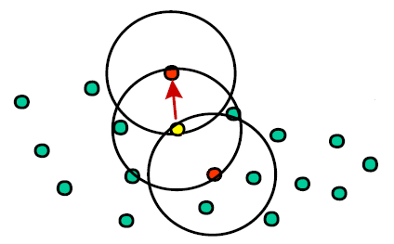
OPTICS Clustering
Density based clustering, a generalization of DBSCAN (Ankerst et al., 1999)
Main parameter:
A size bound minpts
Starting from an arbitrary point we move to the neighbor point of the database that satisfies with the minimum epsilon that at least minpts neighbor has within epsilon distance (moving to the most dense direction);
We visualize the epsilon values: that is the reachability plot.
Could be hiarerchical
Not necessarily spherical
Dimension problem solved!

Slide 2
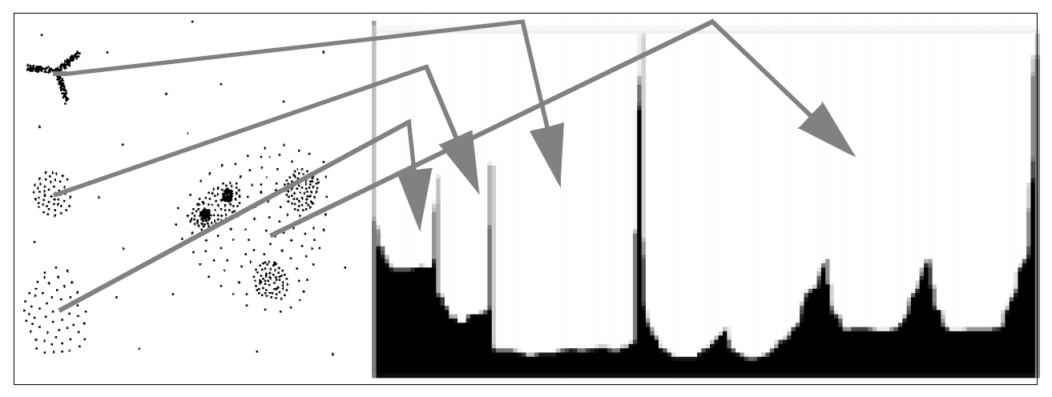
OPTICS reachability plot
hierarchical structure

Slide 3
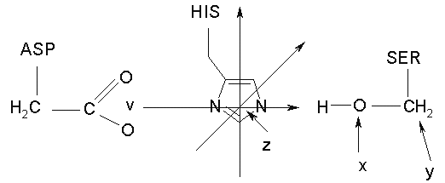
Clustering cathalitic triads
Az ASP, HIS, SER is at least 10 aa far
d (v, z) < 4.5 Ǻ
d (x, z) < 4.5 Ǻ
vzx angle > 120°

Slide 4
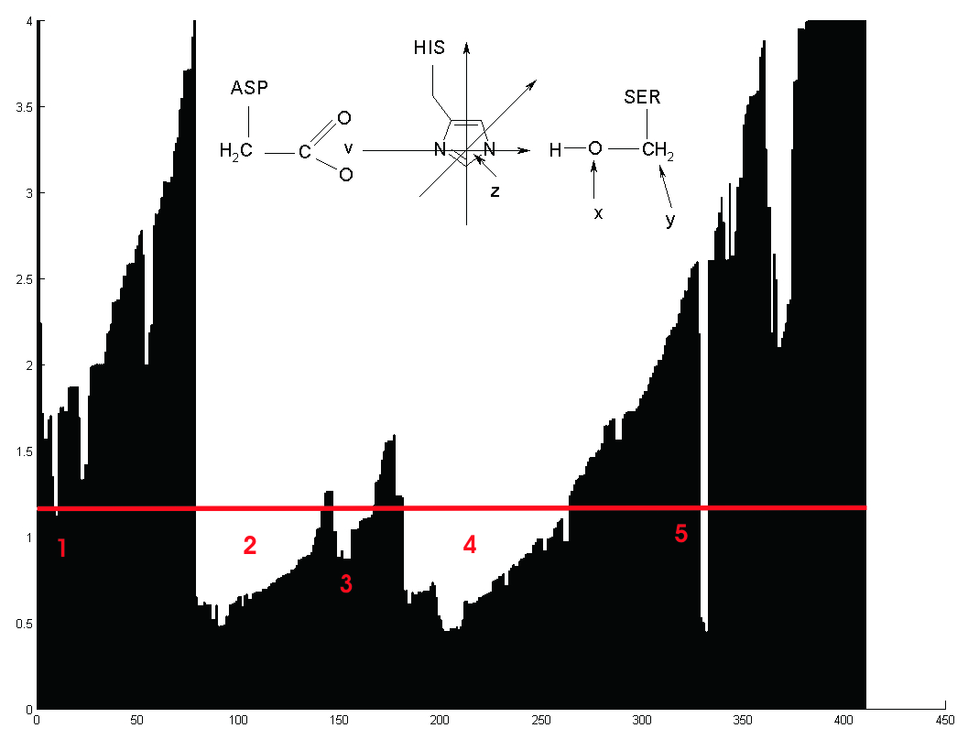
OPTICS results for triads
OPTICS minpts = 5;
X axes: ordinal of object
Y axes: epsilon

