Slide 1
Graphs in bioinformatics
Vince Grolmusz

Slide 2
Scientometrics and graphs
Citation
Co-citation
Impact factor of journals
Erdős number

Slide 3
Citation
For a scientific publication: the number of papers that cite the given paper.
E.g.:

Slide 4
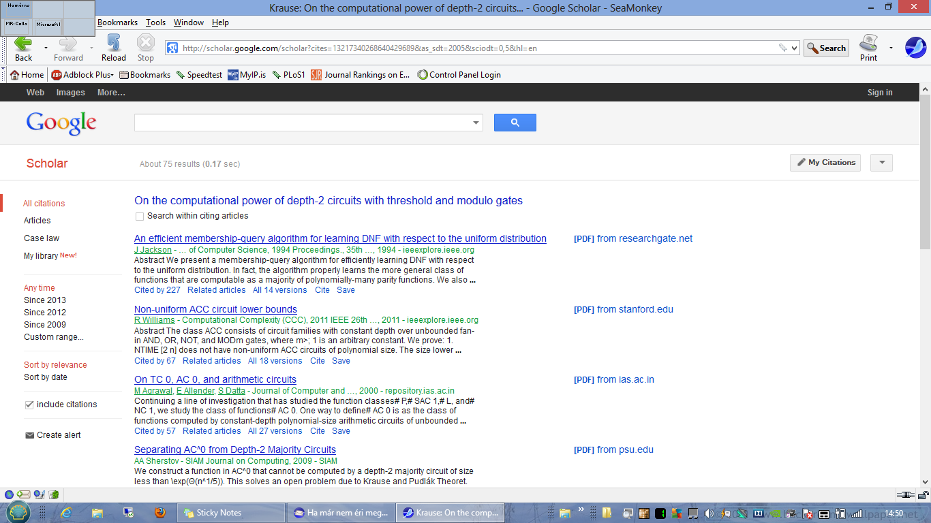

Slide 5
Co-citation of two publications:
The number of publications that cite both of them;
Without knowing the topic of the two publications, if their co-citation is high-
probably their topic is related.

Slide 6
Impact factor of scientific journals
Let A be a journal. The IF for year 2012 is defined as follows:
Let citation(A) be the number of citations to the papers published in A in the two years (2010-11) received in the last full calendar year (2012);
Let n(A) be the number of papers published in A in 2010-12;
IF(A)= citation(A)/n(A).

Slide 7
H-index
A scientist has H-index n, if n is the largest number that (s)he has n papers, each with at least n citations.
Paul Erdős has h-index 101

Slide 8
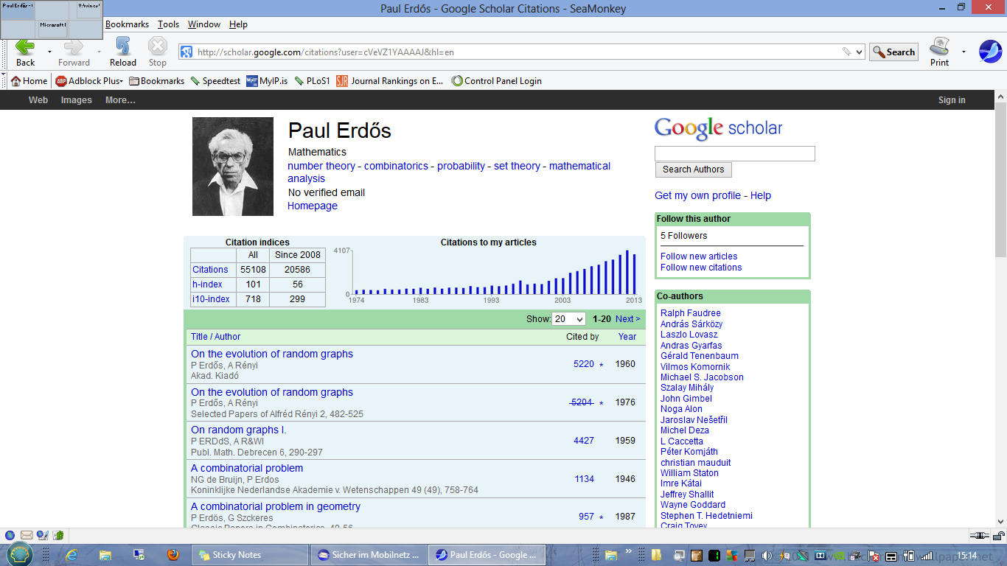

Slide 9
Erdős number
Erdős has an Erdős number of 0.
Consider a graph: vertices scientists, two scientists are connected by an edge if they co-authored a scientific paper.
The Erdős number of a scientist is the distance of the scientist on this graph from Erdős.

Slide 10
Graphs in biology
We have seen: phylogenetic trees
Now: Graphs on proteins
Physical interaction graphs
or metabolic graphs

Slide 11
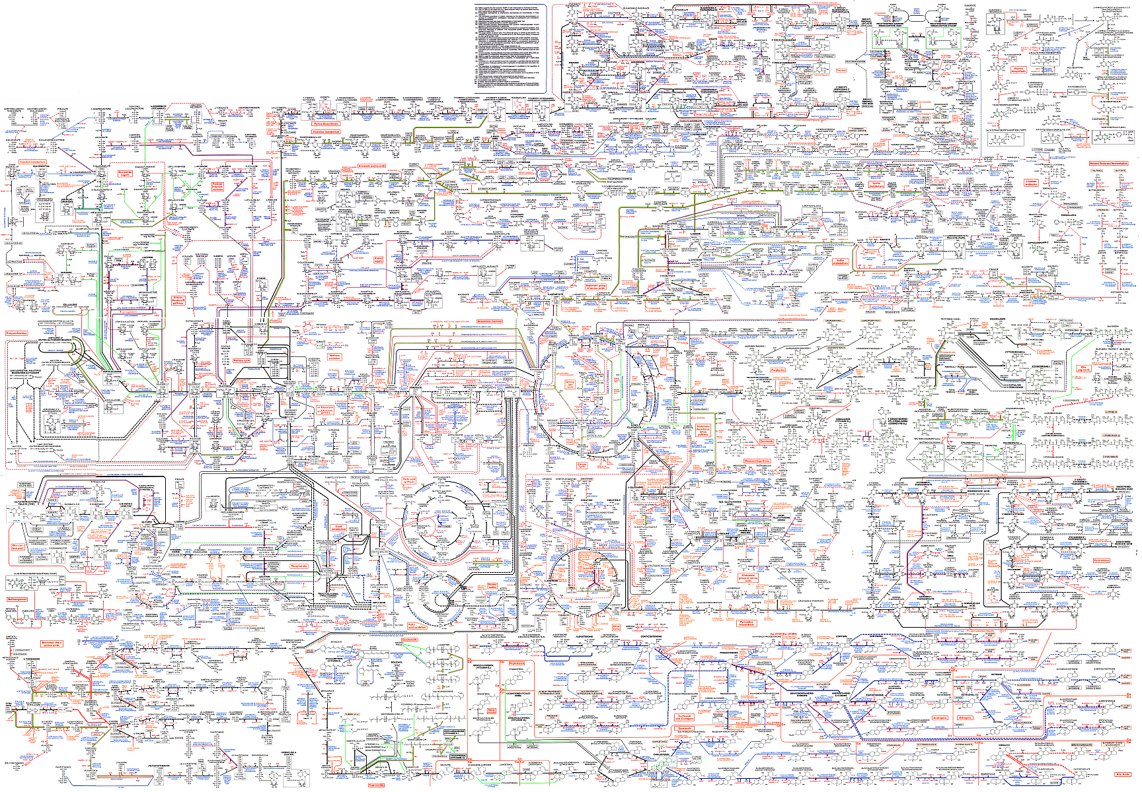
Boehringer „Metabolic pathways” poster

Slide 12
Target proteins
Proteins are main players in the life of the cell;
Almost all of our pharmaceutical drugs work on proteins, or have effects on proteins,
E.g., penicillin, a potent antibiotics, inhibits the action of an enzyme that builds cell walls of bacteria

Slide 13
Humans have
around 100 000 proteins;
bacteria inside us tens of millions of proteins;
How many of these are targeted today?
We have about 1200 FDA approved drugs,

Slide 14
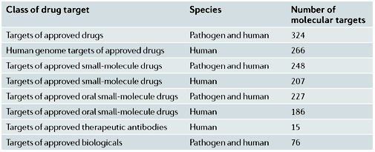
The number of pharmaceutical target proteins
Overington et al. Nature Reviews Drug Discovery 5, 993–996 (December 2006) | doi:10.1038/nrd2199

Slide 15
Very few proteins are targeted
Needed: novel protein targets in diseases; today we will focus on Alzheimer’s disease.
How to choose new targets:
- Similarity to old targets (this is the old method);
- Expert opinion
- Objective method

Slide 16
Protein-protein interaction network analysis
The goal: finding important proteins, based on the relation to other proteins in the network.
What types of networks can be considered?

Slide 17
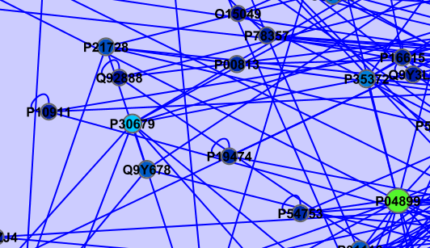
Protein networks considered
Physical interaction networks:
nodes: proteins; two protein is connected by an edge if they interact.
Interactions can be:
measured {TAP, Y2H,
co-immunoprecitipation, etc.},
predicted
undirected graphs:
Goal: finding important nodes in protein
networks

Slide 18
Public physiscal interaction network
depositories
MINT (UniRoma): 112 957 edges, 29 587 proteins,
measured,
DIP (UCLA): 57 683 edges, 20 728 proteins, measured,
HPRD (Johns Hopkins): 38 806 edges, 27 801 proteins, only human proteins
IntAct (EMBL-EBI): 195 719 edges, 59 017 proteins,
Goal: finding important nodes in protein
networks

Slide 19
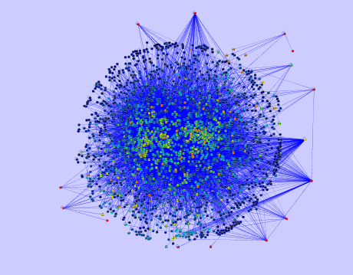
So, we have a nice, large network...
How to find important nodes in it?
How to define „important nodes”?

Slide 20
There are very good solutions for finding important nodes in a network
... in WWW search engines, like Google.

Slide 21
Diversion: How a web search engine (like Google search) works?
Downloads the whole web (robot, crawler)
local storage
indexing (e.g., on page 3 the word 2 is „bacterium”)
Inverse indexing (like subject index in a book) „The word „bacterium” appears in pages .. and in positions...”
When we search for the word „bacterium” it will find

Slide 22
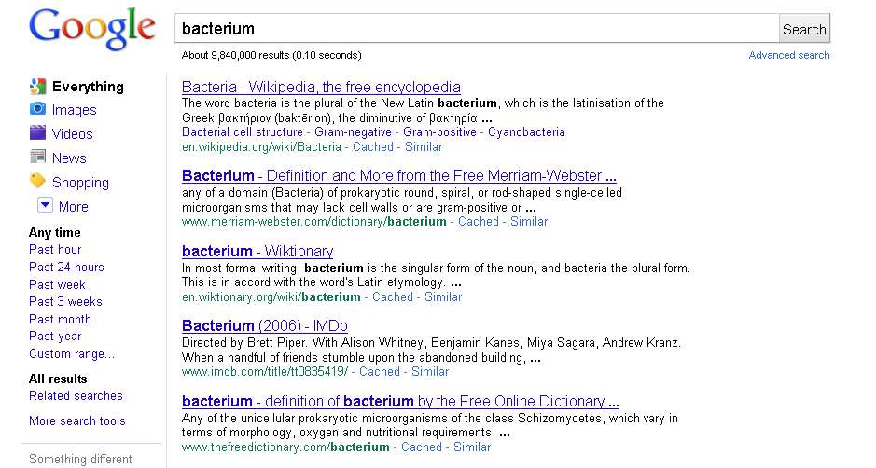
Google would not be one of the most influential
companies today if we were given 10 million results to
choose from;
It gives us the important ones first.
HOW?

Slide 23
Common error:
NOT the most popular pages are returned first;
Google does not know how many times a WWW page is seen (in a clear scenario, only the owner of the webpage visited and the visitor know this.
(this is not entirely true today, e.g., Chrome logs the visits, but I will not go into details here)

Slide 24
Google examines the web-graph:
Web-graph:vertices: the pages of the WWW;
edges: A B, if page A (hyper)links to B;
DEF 1 : A page or a node is important:if it is referenced to
or linked to a lot of times;
in-degree=4
Numerous applications: scientometry,
citation number,
impact factor
disadvantage:the referrers’ quality is
not taken into account!
Goal: finding important nodes in protein
networks

Slide 25
DEF 2: Important webpage/node: is referred to by lots of important nodes...
Circulus vitiosus in this form, but it can be turned to a mathematical recursion,
therefore a rigorous definition (details are omitted here).
Importance is inherited from the referrer.

Slide 26
A person walks on the vertices of the graph: in a vertex,
- with 80% probability he choses one of the outgoing edges with uniform distribution
- with 20% probability he teleports to any vertices, with uniform distribution
PageRank
The importance of a vertex – or the PageRank of the vertex –
is the limit probability distribution of this walk.

Slide 27
Importance is inherited from the referrer
The limit distribution exists
It is easy to compute
The resulting PageRank was used in the first version of the Google search engine in ordering the hits of the search.

Slide 28
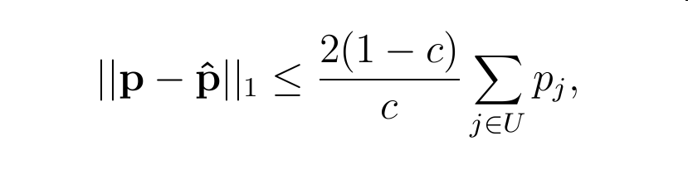
A considerable advantage:
PageRank is robust for erroneous input networks (c is the teleporting probability):
Important property, since PPI networks usually contains lots of errors.

Slide 29
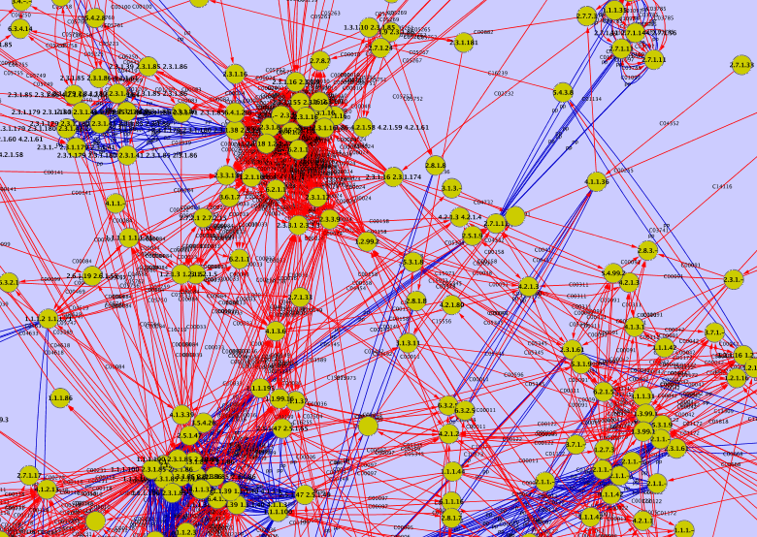
Mtb protein-protein interaction network united with the metabolic network (detail)

Slide 30
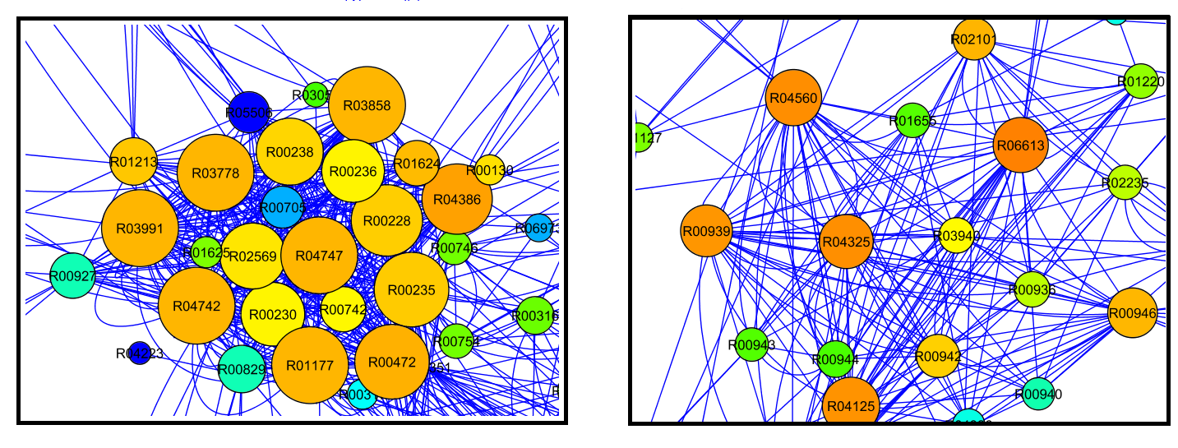
Two examples from the metabolic graph of the Mycobacterium tuberculosis
Vertex size: degree
Vertex color: PageRank

Slide 32
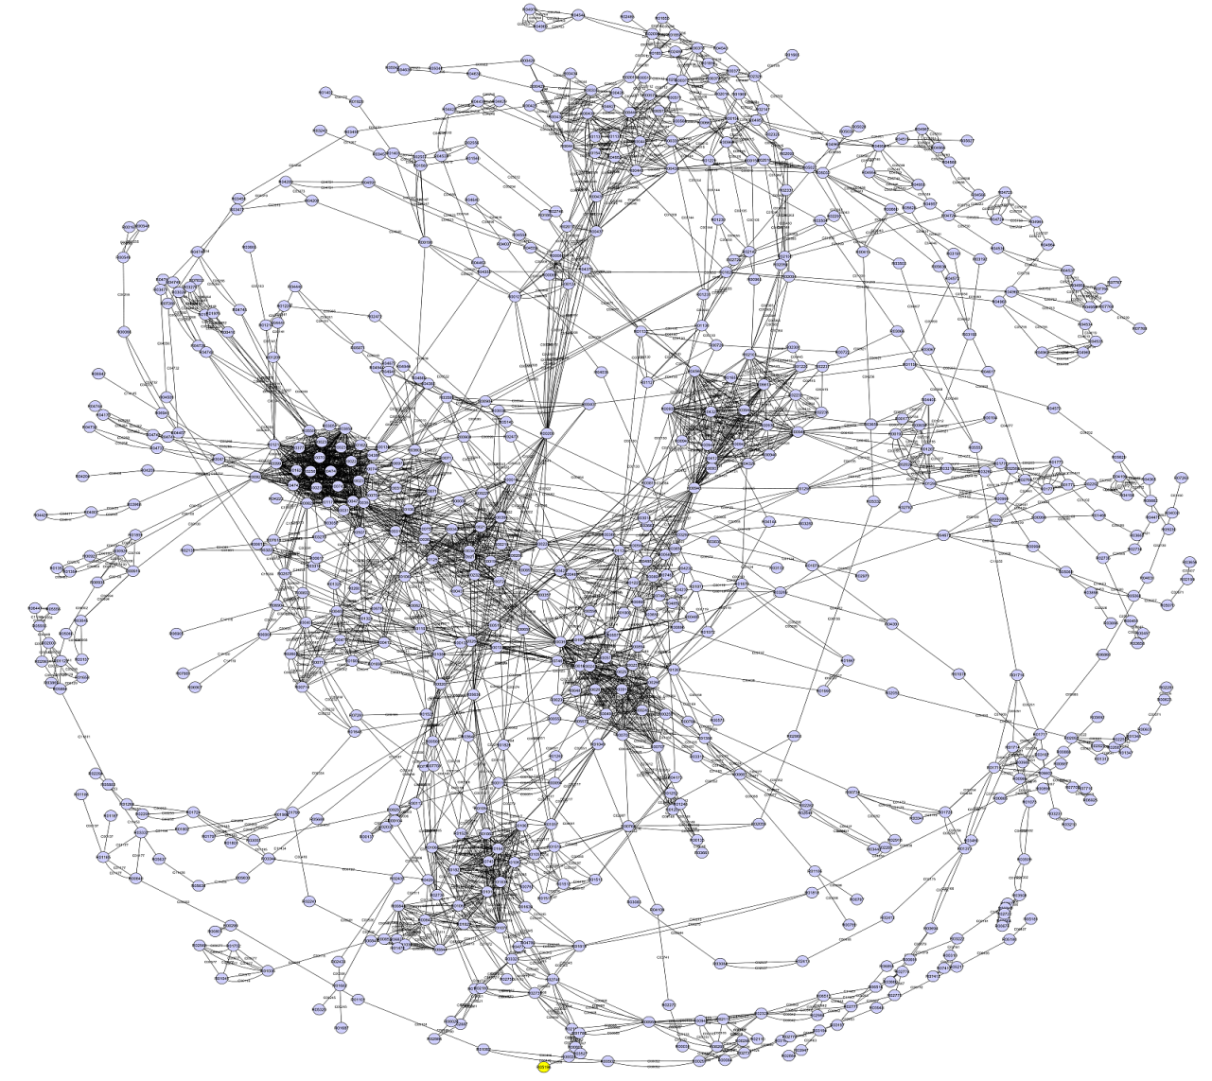
The metabolic network of Mtb
(CytoScape, spring embedded layout)
678vertices

Slide 33
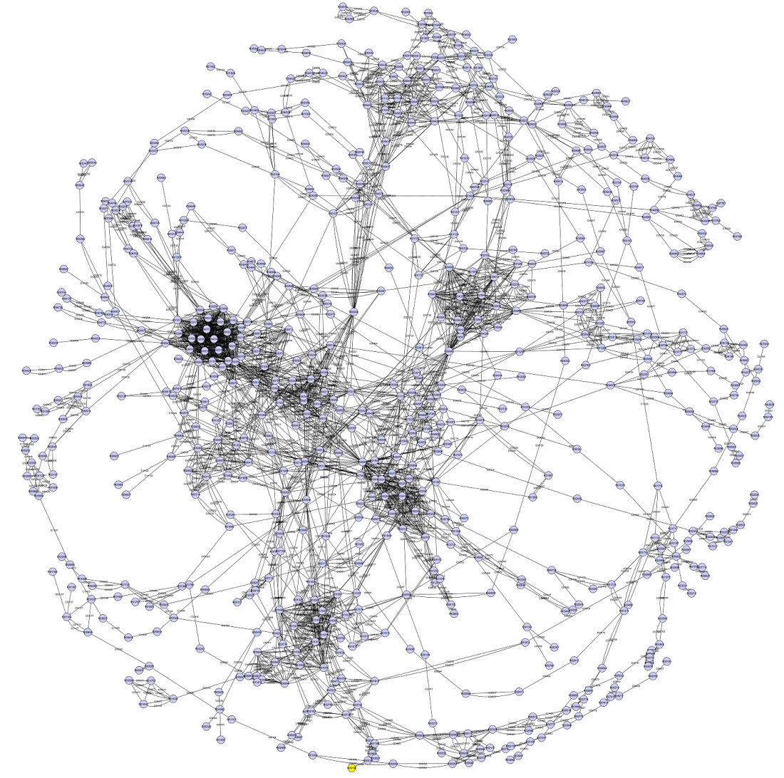
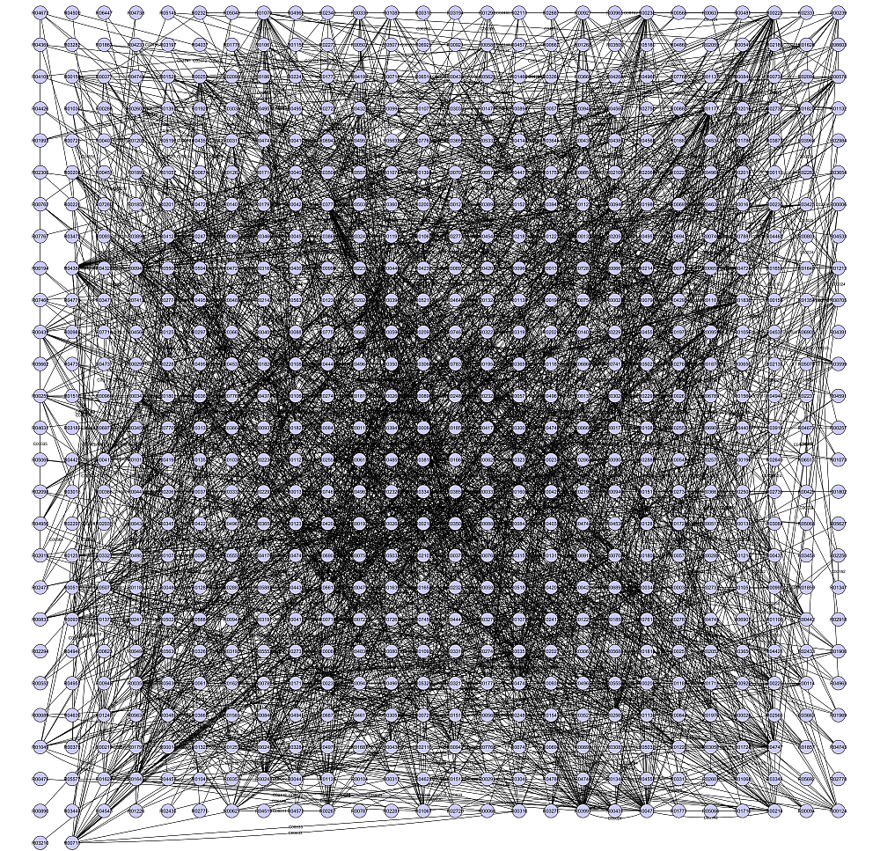
Good and bad visualizations of graphs

Slide 34
Personalized PageRank
When the teleporting is made to only a subset of vertices, it is the personalized PageRank.
The term comes from search engines: if somebody is fond of sports or cars, then his surfing behaviour is well described by teleporting to sports-related pages or car-related pages; those pages will got much higher PageRanks
But not only those! Also car tunning, car race, car parts, car models, driving, car manufacturers, etc. So the related pages will also get high PageRanks, while unrelated pages, e.g., diving, will probably not.

Slide 35
Alkalmazás proteomikai adatok analízisére
Forgber et al (PlosOne 2009.) in the blood serum of
melanoma patients measured the elevated concentration of
the following proteins:
Enolase 1: P06733
Calumenin: O43852
HSP70 protein B: P08107
2,4-dienoyl-CoA reductase: Q9NUI1
Aldolase A: P04075
Fumarate hydratase: P07954
Aldose reductase: P15121
HSP70 protein 9B: Q96EY1
Aconitase 2: P21399
hnRNP1: P26599
VCP: P55072
LDH H: P07195
LAP3: Q944P7
UniProt accession numbers

Slide 36
We considered the human interactome deposited in the 38 806 edges, 27 801 nodes);
personalized to the measured values given in the previous page;
and listed the nodes with the greatest PageRank:

Slide 37
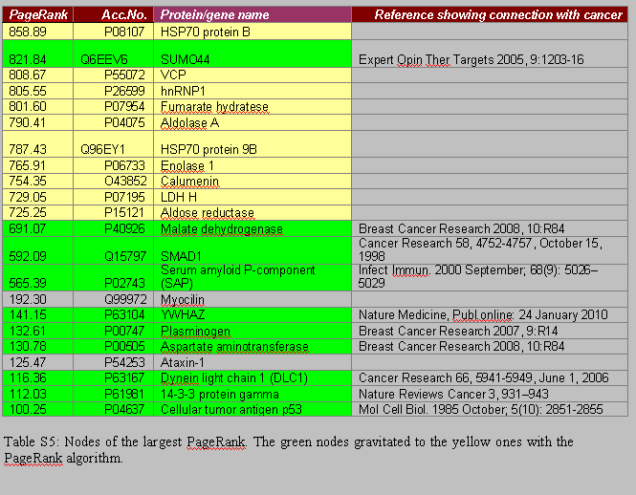


Slide 38

2356 vertices 13694 edges, radius-2 environment

Slide 39
Relative PageRank
PageRank in undirected graphs are approximately proportional to the degree;
Consider the quotient PageRank(v)/deg(v)
This is approximately constant for any vertex in an undirected graph.
Its large value is independent from the hub property, it depends only on the intrinsic graph/network properties.

Slide 40
In undirected graphs (e.g., physical interaction graphs) the
PageRank of a node v is approximately proportional to the
degree of node v, therefore it will not give much information
relative to simple degree counting.
Metabolic graphs are directed graphs, so it is interesting
to compute PageRank for them.
Usually large-degree nodes have
large PageRank. Consequently it is especially
interesting to find low-degree vertices with high
PageRank.
Example:Mtb’s mycolic acid pathway

Slide 41
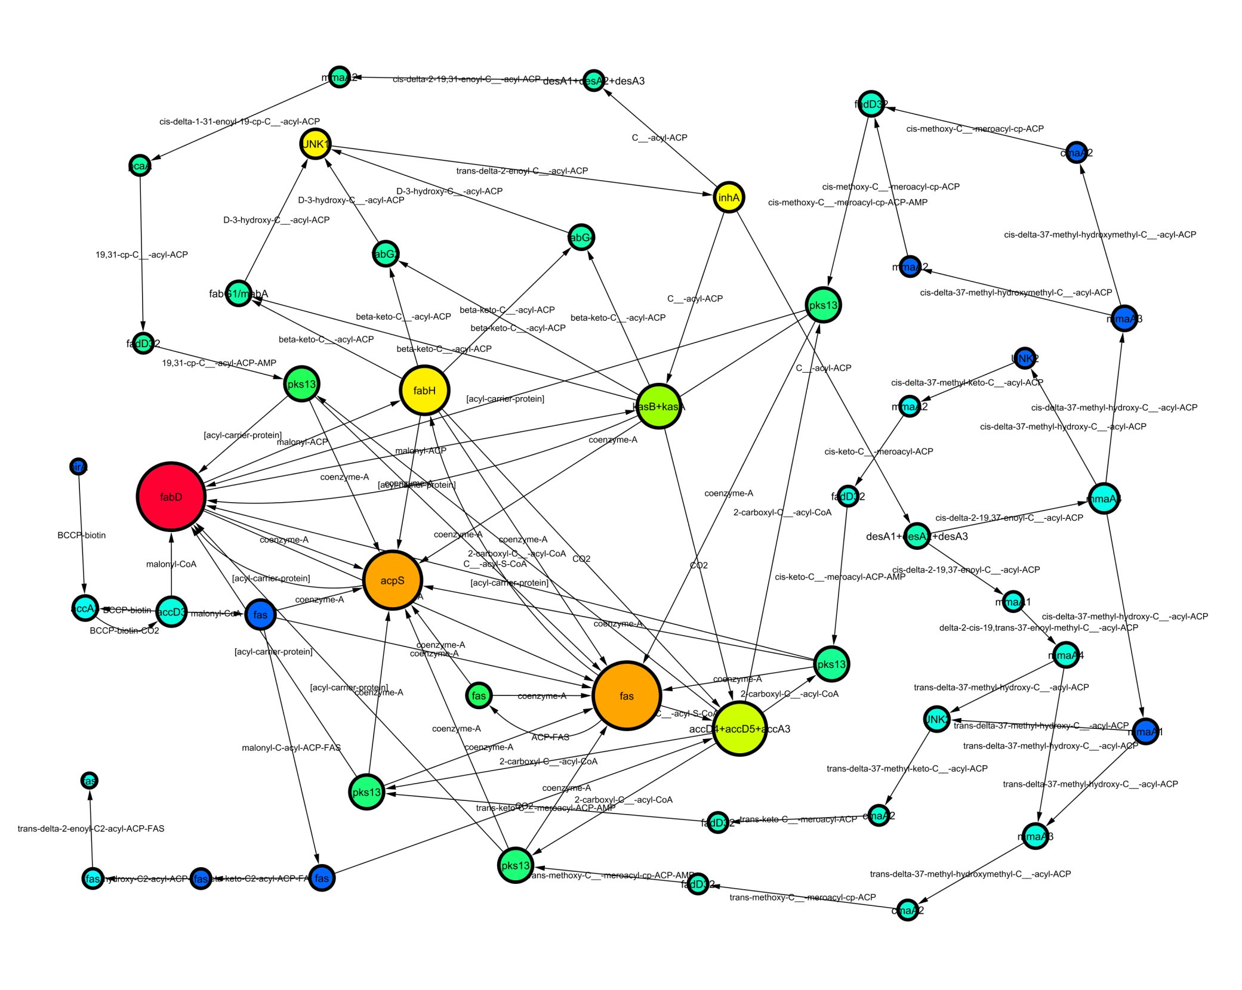

Slide 42
Relative PageRank
PageRank in undirected graphs are approximately proportional to the degree;
Consider the quotient PageRank(v)/deg(v)
This is approximately constant for any vertex in an undirected graph.
Its large value is independent from the hub property, it depends only on the intrinsic graph/network properties.

Slide 43
The quotient for the mycolic acids pathway:
Node ID | PageRank | In-Degree | PageRank/In-Degree
 | scaled
inhA isoniazid t. | 13.0 | 1 | 13.0
fabH | 14.7 | 2 | 7.3
kasB kasA | 11.8 | 2 | 5.9
UNK1 | 14.1 | 3 | 4.7
fabD | 33.2 | 8 | 4.2
pks13 | 7.7 | 2 | 3.9
fas | 7.6 | 2 | 3.8
accD5,accD4,accA3 | 12.4 | 4 | 3.1
acpS | 23.3 | 9 | 2.6
fas | 23.3 | 9 | 2.6

Slide 45
We prepared the same analysis
for the whole Mycobacterium tuberculosis,
Plasmodium falciparum
and MRSA Staphylococcus
networks.
We have found several known and lots of (still) unknown, non-hub important nodes, possible novel drug targets.

Slide 46
Plasmodium falciparum high scores
reaction ID | PageRank | in-degree | PR/in-degree | protein correspondence
R01940 | 3.78 | 1 | 3.78 | 2-oxoglutarate dehydrogenase (OGDH) EC 1.2.4.2
R00174 | 7.31 | 2 | 3.66 | pyridoxal kinase-like protein, putative (EC:2.7.1.35)
R00173 | 7.31 | 2 | 3.66 | pyridoxal phosphate phosphatase
R08193 | 3.33 | 1 | 3.33 | N-acetyl glucosamine phosphate mutase, putative
R07384 | 3.33 | 1 | 3.33 | ethanolaminephosphotransferase, putative
R07381 | 3.33 | 1 | 3.33 | PI_PLC phospholipase C

Slide 47
Plasmodium falciparum
The highest scoring reaction is R01940 (EC:1.2.4.2, 2-oxoglutarate dehydrogenase (OGDH) E1 component). The related pathways include vitamin B metabolism, a recently suggested target, and relates to alpha-ketoacid dehydrogenase multienzyme complexes, with specificity for Plasmodium falciparum. Glutamate dehydrogenase, catalyzing a closely related reaction, was suggested also as new drug target recently.
Reactions of the second and third largest score (R00174 and R00173, resp.) are corresponded to pyridoxal kinases (EC:2.7.1.35) that are shown to be targets of Roscovitine. It is reported that inhibiting pyridoxal 5-phosphate-dependent enzymes kills the parasite efficiently.
The fifth largest scoring reaction, R07384, corresponded to putative ethanolaminephosphotransferase, is reported very recently to be essential in Plasmodium berghei.
The sixth largest scoring reaction, R07384, corresponding to PI_PLC phospholipase C, is a well studied plasmodium target

