Slide 1
Molecular docking
Vince Grolmusz

Slide 2
Some background: the pharmaceutical industry
New drugs increased the life expectancy in the last century:
For the children born today in Kuwait it is 80 years
In 1900 in US it was 48 years.
Key factor: better health care

Slide 3
+ New knowledge
Example: Stomach ulcers
Helicobacter pylori was discovered in 1982 by two Australian scientists, Robin Warren and Barry J. Marshall as a causative factor for ulcers. In their original paper, Warren and Marshall contended that most gastric ulcers and gastritis were caused by colonization with this bacterium, not by stress or spicy food as had been assumed before.

Slide 4
The H. pylori hypothesis was poorly received, so in an act of self-experimentation Marshall drank a Petri dish containing a culture of organisms extracted from a patient and five days later developed gastritis. His symptoms disappeared after two weeks, but he took antibiotics to kill the remaining bacteria at the urging of his wife. This experiment was published in 1984 in the Australian Medical Journal and is among the most cited articles from the journal.

Slide 5
In 1997, the Centers for Disease Control and Prevention, with other government agencies, academic institutions, and industry, launched a national education campaign to inform health care providers and consumers about the link between H. pylori and ulcers. This campaign reinforced the news that ulcers are a curable infection, and that health can be greatly improved and money saved by disseminating information about H. pylori.^{[36]}
In 2005, the Karolinska Institute in Stockholm awarded the Nobel Prize in Physiology or Medicine to Dr. Marshall and his long-time collaborator Dr. Warren "for their discovery of the bacterium Helicobacter pylori and its role in gastritis and peptic ulcer disease." Professor Marshall continues research related to H. pylori and runs a molecular biology lab at UWA in Perth, Western Australia.

Slide 6
Suggested reading:
http://pdb.org/pdb/101/motm.do?momID=29

Slide 7
In silico pharmacologic research
Virtual pharmacologic research: with computers instead of wet labs.
Today it is just a dream:
Models are not exact;
Methods are not exact enough;
Can be used for getting ideas and decreasing the number of wet lab experiments.

Slide 8
Where we get targets from?
1: Consultation with biologists and MD’s;
23 000 human gene, 100,000 proteins.
200-300 proteins are targeted today(!)
2: Mathematical method: protein network analysis (to be covered here).

Slide 9
We need the 3D structure of the protein
The PDB www.pdb.org
some annotated versions, like: PDBSum

Slide 10
Where can we get the small molecules from?
The perfect solution: real drug libraries & wetlabs
Only the largest firms have large drug libraries;
Problems on the maintenance

Slide 11
Virtual (in silico) drug libraries
Advantages:
Will not be changed in time;
Can be shared easily
You do not need to buy all the molecules, just those that are good
Best collection: ZINC (UCSF, Shoichet Lab); more than 15 million molecules

Slide 12
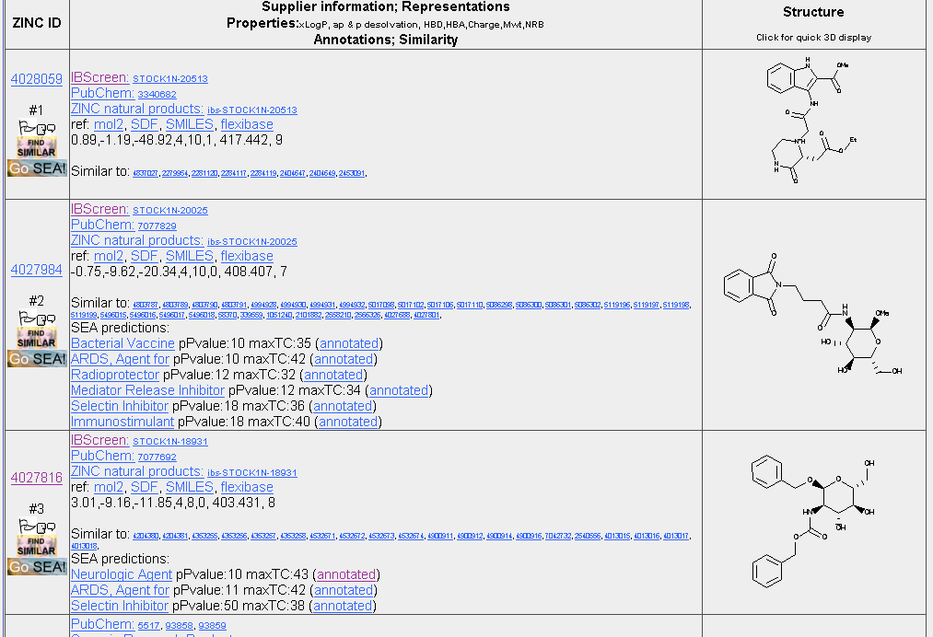
One page of ZINC:

Slide 13
Some important molecules
Cimetidine, the prototypical H₂-receptor antagonist from which the later members of the class were developed
Dorzolamide, a carbonic anhydrase inhibitor used to treat glaucoma
Enfuvirtide, a peptide HIV entry inhibitor
Nonbenzodiazepines like zolpidem and zopiclone
Zanamivir, an antiviral drug, Oseltamivir
Prozac, Xanax
Warfarin blood thinner

Slide 14
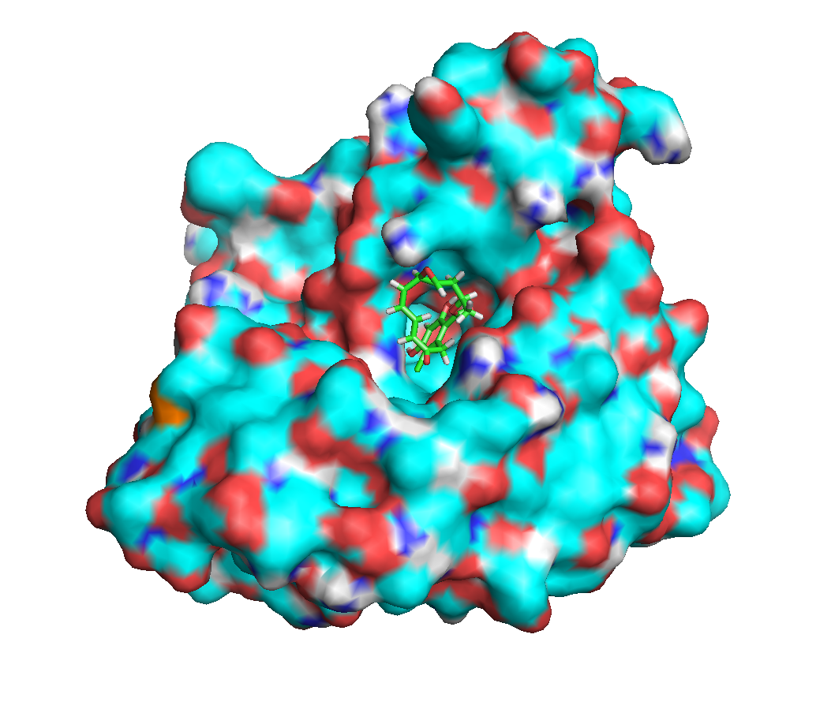
The docking problem mathematically
Given a small drug-like molecule and a large protein, both with 3D structures; we need to predict the
Energy change if they bind
the structure of the complex.
Tasks:
„Scoring”: assign an energy value (i.e., potential) for each configuration of the drug;
Docking: minimizing the energy function above

Slide 15
Modeling the protein and the small molecule
Protein-atoms have the attributes:
Atom type: { H, C, N, O, S, P }
coordinates: 3D vektor
Partial charge
Additional attributes for O and H atoms
Ligands or small drug-like molecules:
Atom types: { H, C, N, O, S, P, F, Cl, Br, I}
Coordinates
Bound types: rotatable or not
Notes:
Receptornál a nemdőlt betűs tagok közvetlenül rendelkezésre állnak a .pdb file-ban

Slide 16
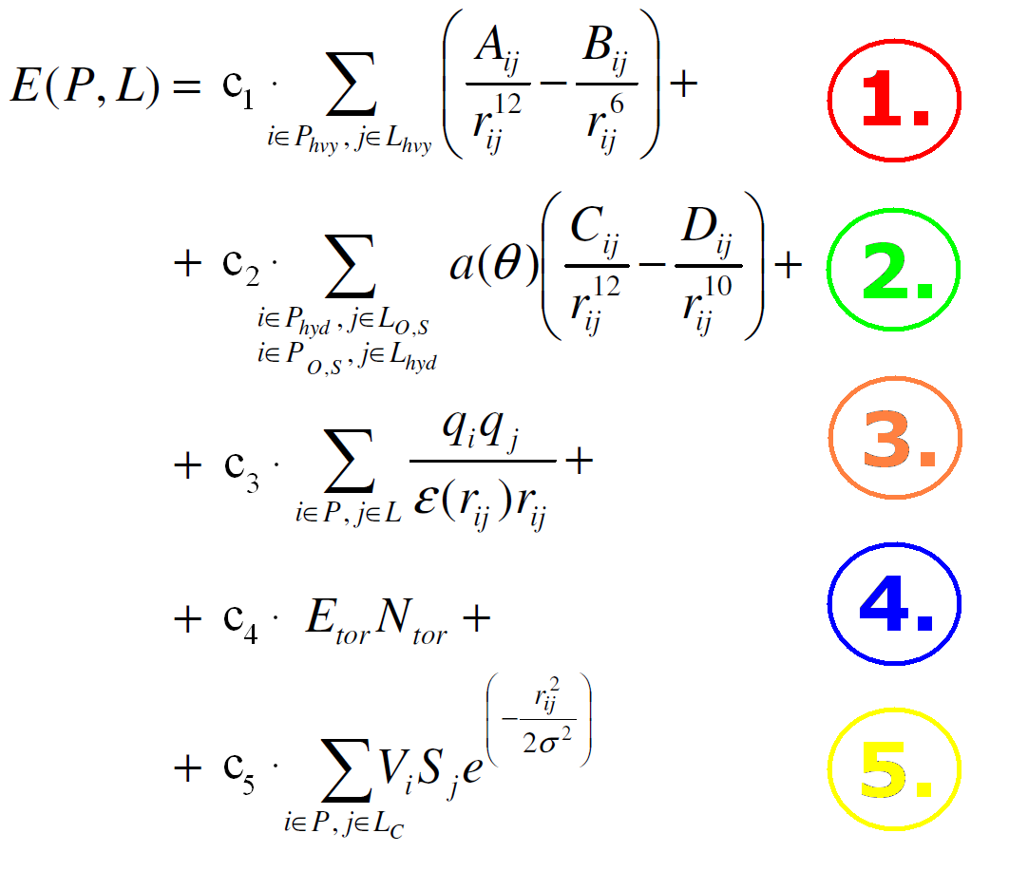
Energy function

Slide 17
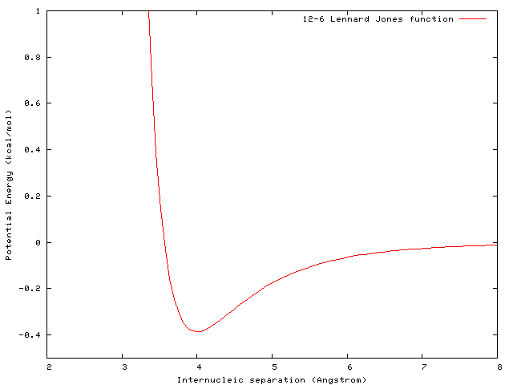
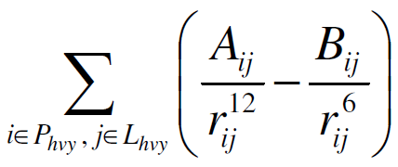
1.: Lennard-Jones potential
Need to be summed for all non-hydrogen atom-pairs
Az L-J potential depends on r_{ij} and:
A and B constants, that depend on the atom types

Slide 18
H-bond
A hydrogen bond is formed by three atoms:
one hydrogen atom
and two electronegative atoms (often N or O).
The hydrogen atom is covalently bonded to one of electronegative atoms, called the hydrogen bond donor. The other electronegative atom is named the hydrogen bond acceptor.
The two electronegative atoms may take up some electron density from the hydrogen atom.
The bond energy usually ranges from 1 kcal/mol to 5 kcal/mol. This energy is smaller than covalent bond energy, but greater than thermal energy (0.6 kcal/mol at room temperature). Therefore, the hydrogen bond can provide a significant stabilizing force in macromolecules such as proteins and nucleic acids.
When a hydrogen bond is formed, the distance between the donor and the acceptor is about 2.8 A .

Slide 19
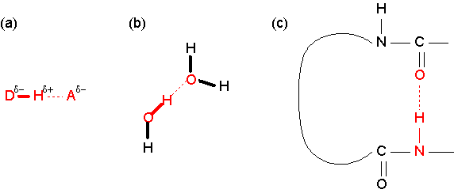

Slide 20
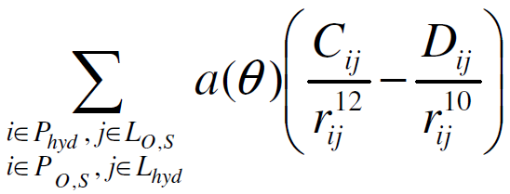
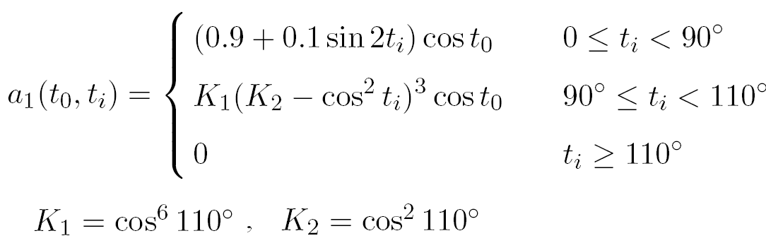
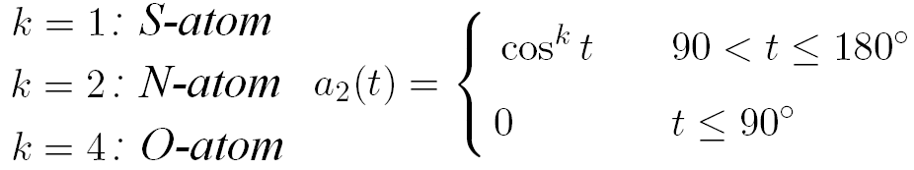
2.: H-bonds
Notes:
A szummába kell az n ATOM IS

Slide 21
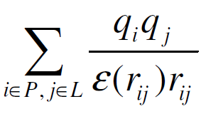
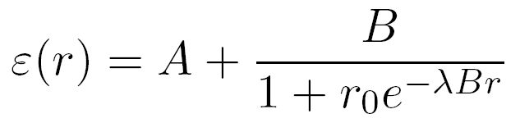
3.: Electrostatic interaction
q_{i}, q_{j}: „partial charge”: abstractions; with them we approximate tha real electrostatic space
dielectric factor of the solute, no details are given.

Slide 22
4: Torsion energy
Small molecule lost its torsion freedom
An entropy-like quantity

Slide 23
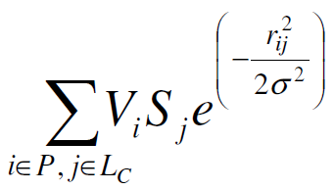
5.: Counting with water molecules

Slide 24
6.: Inner energy of the ligand
van der Waals energy summation for the small molecule atoms
Notes:
Miert k, miert nem 6

Slide 25
The grid idea
Instead of computing everything everywhere, we define a grid, and pre-compute the energy
E^{t}_{P} (x) : egyetlen ligandatomnak a teljes fehérjével való interakciójának energiája (minden lehetséges ligandatom-típusra kiszámoljuk – ez kb. 10 atomtípus)
Q_{P} (x) : elektrosztatikus potenciál a fehérje környezetében
A fenti mennyiségek használatával az energiafüggvény az alábbi alakba írható:

Slide 26
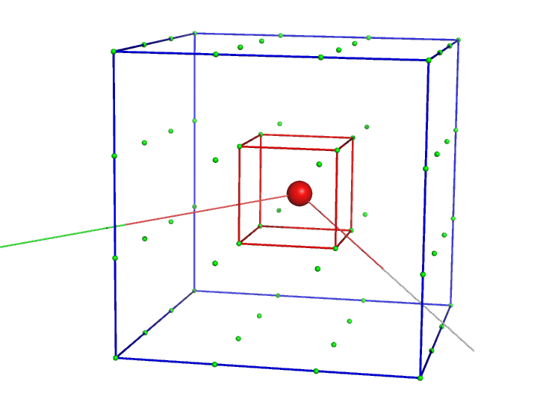
If our atom is not exactly in the gridpoint, we need to approximate
Notes:
Figyeljük meg a következő slide-okon, hogy tényleg a környező 64 gridpontbeli energiaértéket fogjuk használni! ;) /I.G./

Slide 27
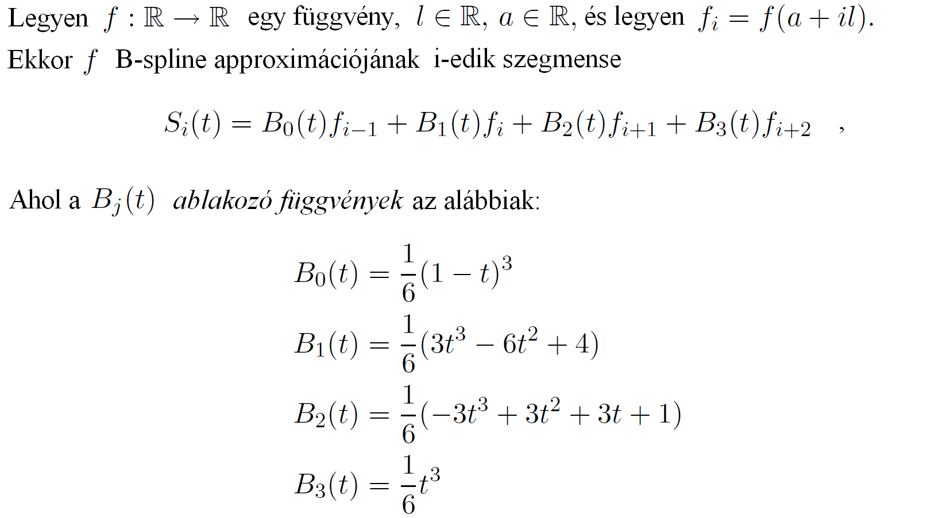
B-spline approximation

Slide 28
General structure of a local approximation algorithm
Input: the function to be optimized and the starting point of the optimization
Initializing:
Cycle:
Halt, if:

Slide 29
One possible solution:
The Conjugated Gradient Method that
produces the local optima if our functions are
locally quadratic;
Our functions can be considered to
be locally quadratic.

Slide 30
Big difference between local and global optimization

Slide 31
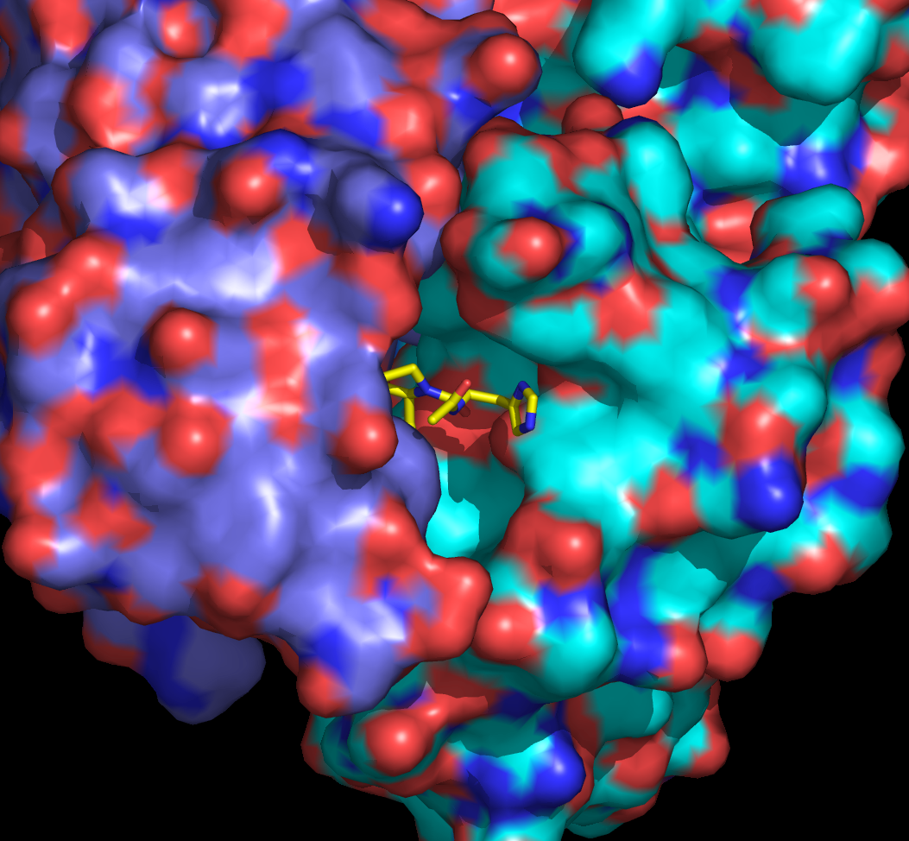
Some good hits

Slide 32
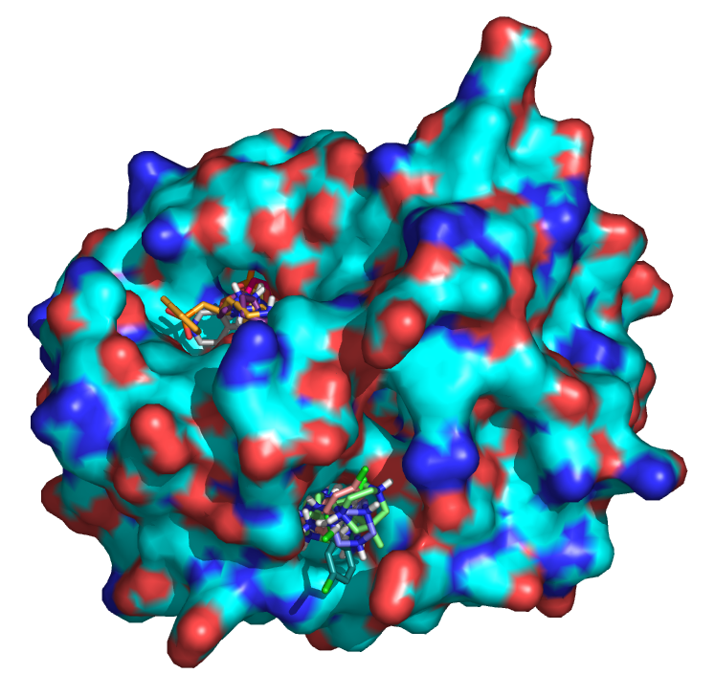
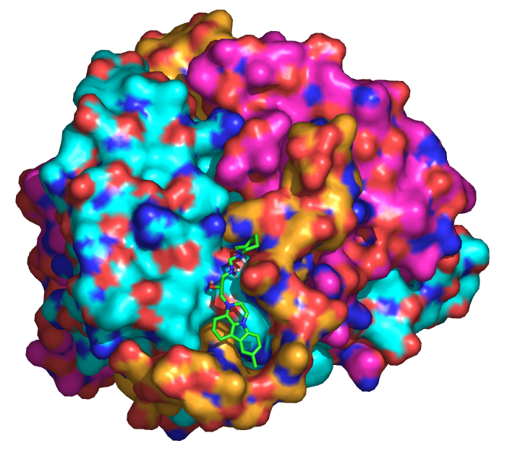
Some other hits

Slide 33
