Slide 1
X-ray Crystallography
Kalyan Das

Slide 2
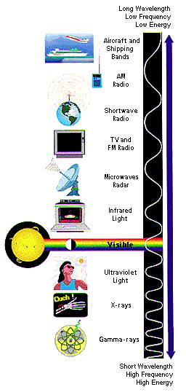
Electromagnetic Spectrum
X-ray radiation was discovered by Roentgen in 1895.
X-rays are generated by bombarding electrons on an metallic anode
Emitted X-ray has a characteristic wavelength depending upon which metal is present.
e.g. Wavelength of X-rays from Cu-anode = 1.54178 Å
E= hν= h(c/λ)
λ(Å)= 12.398/E(keV)
NMR
10 um - 10 mm
700 to 10⁴ nm
400 to 700 nm
10 to 400 nm
10⁻¹ to 10 nm
10⁻⁴ to 10 ⁻¹ nm

Slide 3
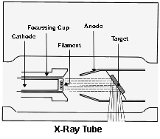
X-ray Sources for Crystallographic Studies
Home Source – Rotating Anode
M-orbital
L-orbital
K-absorption
K_{β}
K_{α1}
K_{α2}
K-orbital
Wave-lengths
Cu(K_{α1})= 1.54015 Å; Cu(K_{α2})= 1.54433 Å
Cu(K_{α})= 1.54015 Å
Cu(K_{β})= 1.39317 Å

Slide 4
Synchrotron X-rays
Electron/positron injection
X-ray
Storage Ring
X-rays
Electron/positron
beam
Magnetic Fields

Slide 5

Crystallization
Slow aggregation process
Protein Sample for Crystallization:
Pure and homogenous (identified by SDS-PAGE, Mass Spec. etc.)
Properly folded
Stable for at least few days in its crystallization condition (dynamic light scattering)

Slide 6
Conditions Effect Crystallization
- pH (buffer)
- Protein Concentration
- Salt (Sodium Chloride, Ammonium Chloride
etc.)
- Precipitant
- Detergent (e.g. n-Octyl-β-D-glucoside)
- Metal ions and/or small molecules
- Rate of diffusion
- Temperature
- Size and shape of the drops
- Pressure (e.g. micro-gravity)

Slide 7
Hanging-drop Vapor Diffusion
Drop containing protein sample for crystallization
Cover Slip
Well
Precipitant

Slide 8
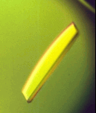
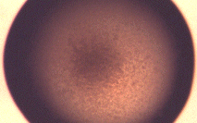
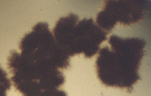
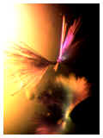
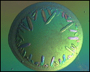
Screening for Crystallization
pH gradient
4
5
6
7
8
9
10 %
15 %
Precipitant Concentration
20 %
30 %
Fiber like Micro-crystals
Ideal crystal
Precipitate
Crystalline precipitate
Small crystals

Slide 9
Periodicity and Symmetry in a Crystal
A crystal has long range ordering of building blocks that are arranged in an conceptual 3-D lattice.
A building block of minimum volume defines unit cell
The repeating units (protein molecule) are in symmetry in an unit cell
The repeating unit is called asymmetric unit – A crystal is a repeat of an asymmetric unit

Slide 10
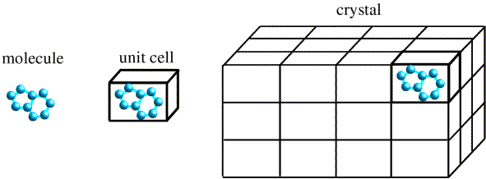

Slide 11
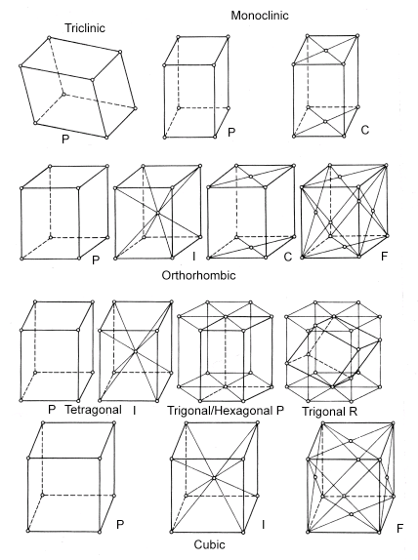
Arrangement of asymmetric unit in a lattice defines the crystal symmetry.
The allowed symmetries are 2-, 3, 4, 6-fold rotational, mirror(m), and inversion (i) symmetry (+/-) translation.
Rotation + translation = screw
Rotation + mirror = glide
➔ 230 space groups, 32 point groups, 14 Bravais lattice, and 7 crystal systems

Slide 12
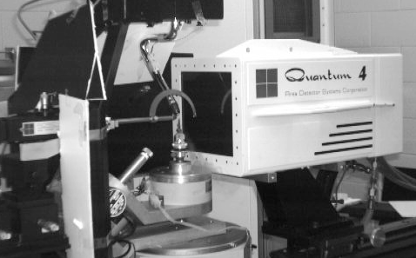
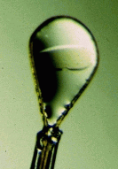
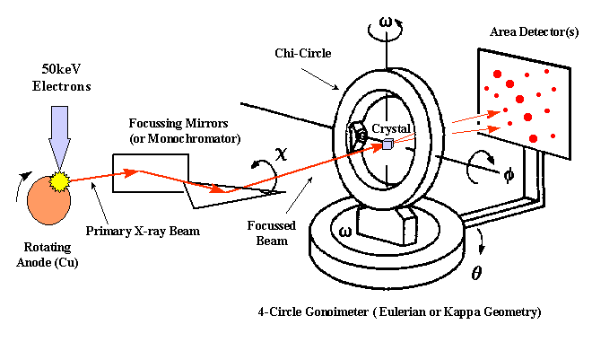
Cryo-loop
Crystal
Detector
Goniometer

Slide 13
Diffraction

Slide 14
Bragg Diffraction
θ
θ
d
d sinθ
For constructive interference 2d sinθ= λ
d- Spacing between two atoms
θ- Angle of incidence of X-ray
λ- Wavelength of X-ray

Slide 15
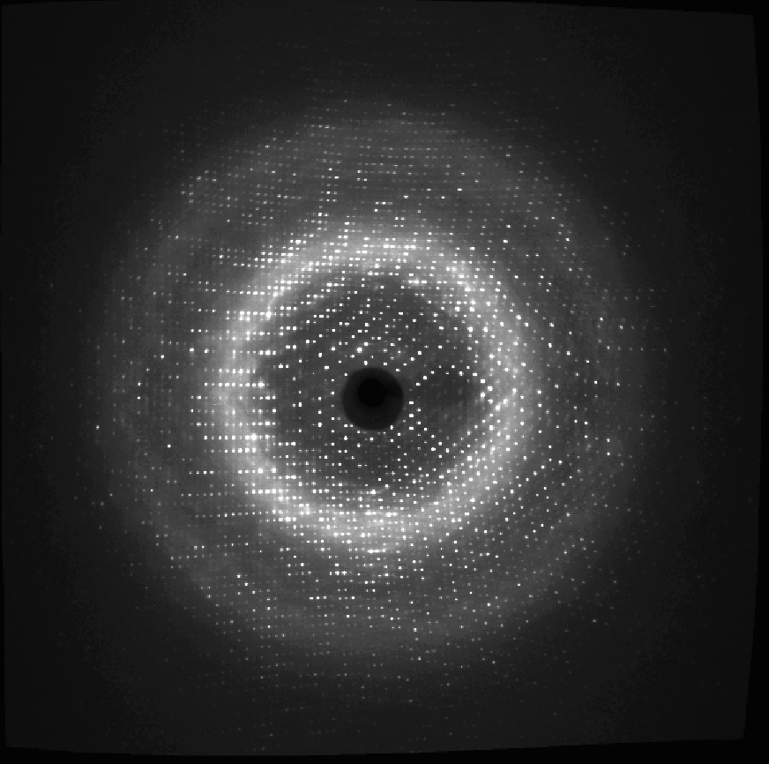
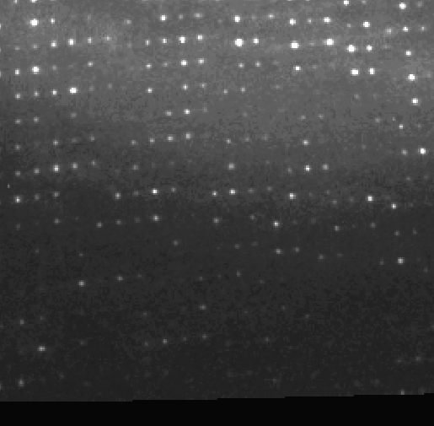
Diffraction from a frozen
arginine deiminase crystal
at CHESS F2-beam line
zoom
1.6 Å resolution
Notes:
Diffraction
1. Typical diffraction pattern from AD collected at F2 beam line at CHESS.
2. Except this data-set all other data, including the heavy atoms derivatives were collected at home using the R-axis at Walkshman institute.

Slide 16
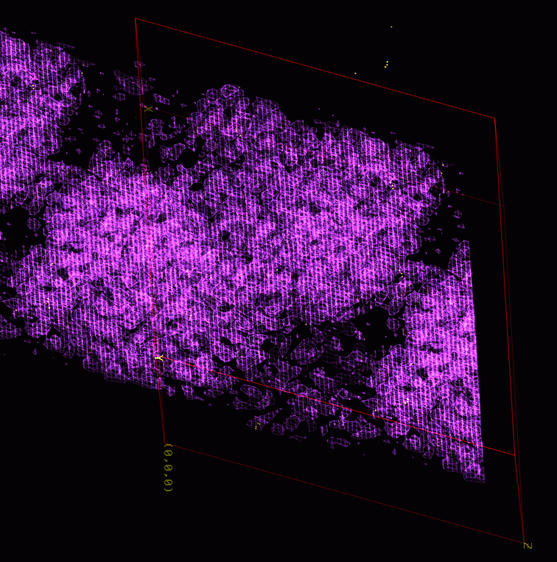
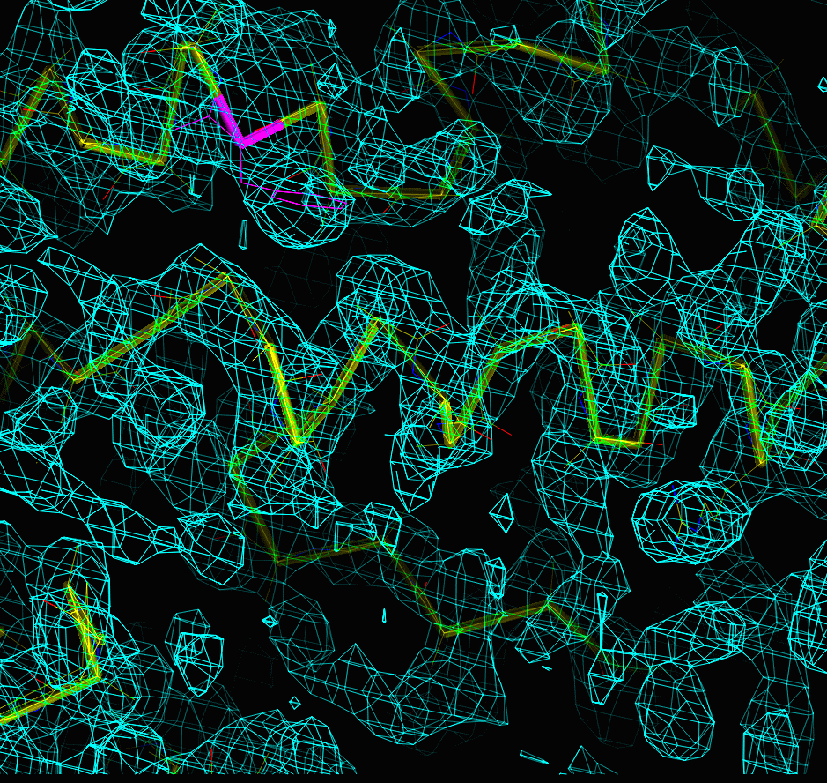
Electron Density Maps
Protein
Solvent
4 Å resolution electron density map
3.5 Å resolution electron density map

Slide 17
Phase Problem in Crystallography
Structure factor at a point (h,k,l)
F(h,k,l)= Σ f_{n} exp [2πi(hx+ky+lz)]
f – atomic scattering factor
N – number of all atoms
F is a complex number
F(h,k,l)= |F(h,k,l)| exp(-iφ)
N
n=1
Reciprocal
Space
phase
amplitude
I(h,k,l)
background
Measured intensity
I(h,k,l)= |F(h,k,l)|²
h,k,l

Slide 18



Electron Density
Structure Factor
F(h,k,l)= Σ f_{n} exp [2πi(hx)]
Electron Density
Friedel's law F(h) = F*(-h)
➔

Slide 19
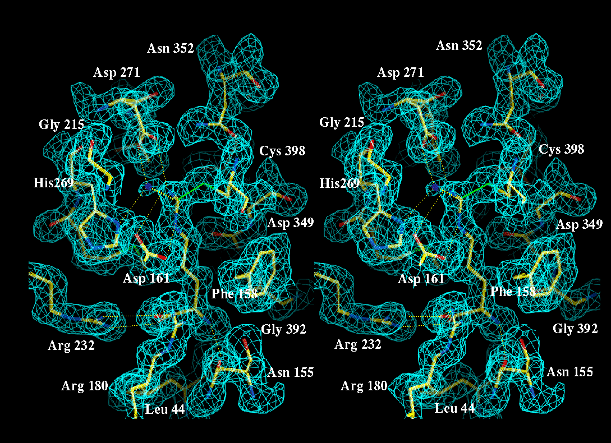
1.6 Å electron density map

Slide 20
Solving Phase Problem

Slide 21
Molecular Replacement (MR)
Using an available homologous structure as template
Advantages: Relatively easy and fast to get solution.
Applied in determining a series of structures from a known homologue – systematic functional, mutation, drug-binding studies
Limitations: No template structure no solution, Solution phases are biased with the information from its template structure

Slide 22
Isomorhous Replacement (MIR)
Heavy atom derivatives are prepared by soaking or co-crystallizing
Diffraction data for heavy atom derivatives are collected along with the native data
F_{PH}= F_{P} + F_{H}
Patterson function P(u)= 1/V Σ|F(h)|2 cos(2πu.h)
= ρ(r) x ρ(r’) dv
→ strong peaks for in Patterson map when r and r’ are two heavy atom positions
h
r

Slide 23
Multiple Anomalous Dispersion (MAD)
At the absorption edge of an atom, its scattering factor f_{ano}= f + f’ + if”
Atom f f’ f”
Hg 80 -5.0 7.7
Se 34 -0.9 1.1
F(h,k,l) = F(-h,-k,-l) → anomalous differences →
positions of anomalous scatterers → Protein Phasing
f_{ano}
imaginary
if”
f
f’
real

Slide 24
Se-Met MAD
Most common method of ab initio macromolecule structure determination
A protein sample is grown in Se-Met instead of Met.
Minimum 1 well-ordered Se-position/75 amino acids
Anomolous data are collected from 1 crystal at Se K-edge (12.578 keV).
MAD data are collected at Edge, Inflection, and remote wavelengths

Slide 25
Model Building and Refinement

Slide 26
Least-Squares Refinement
List-squares refinement of atoms (x,y,z, and B) against observed |F(h,k,l)|
Target function that is minimized
Q= Σ w(h,k,l)(|F_{obs}(h,k,l)| - |F_{cal}(h,k,l)|)²
dQ/du_{j}=0; u_{j}- all atomic parameters

Slide 27
Geometric Restraints in Refinement
Each atom has 4 (x,y,z,B) parameters and each parameters requires minimum 3 observations for a free-atom least-squares refinement. → A protein of N atoms requires 12N observations.
For proteins diffracting < 2.0 Å resolution observation to parameter ratio is considerable less.
Protein Restraints (bond lengths, bond angles, planarity of an aromatic ring etc.) are used as restraints to reduce the number of parameters

Slide 28
R-factor
R_{cryst} = Σ_{hkl} |F_{obs}(hkl) - kF_{cal}(hkl)| / Σ_{hkl} |F_{obs}(hkl)|
Free-R
R-factor calculated for a test-set of reflections that is never included in refinement.
R-free is always higher than R.
Difference between R and R-free is smaller for higher resolution and well-refined structures

Slide 29
Radius of convergence in a least-squares refinement is, in general, low. Often manual corrections (model building) are needed.
Model Building and Refinement are carried out in iterative cycles till R-factor converges to an appropriate low value with appreciable geometry of the atomic model.

Slide 30
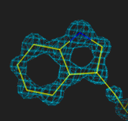
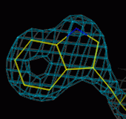
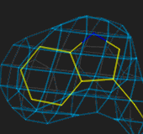
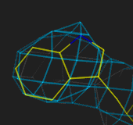
1.0Å 2.5Å
3.5Å 4Å

Slide 31
