Slide 1
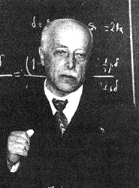
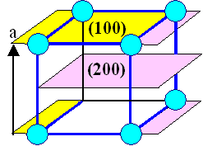
Crystal diffraction
Laue 1912
1914 Nobel prize
Max von Laue
(1879-1960)
Lattice spacing
typically

Slide 2
Today X-ray diffraction supplemented by
electron and neutron diffration
Energies X-ray, electrons and neutrons wave-particle
X-ray:
Electrons:
Neutrons:

Slide 3
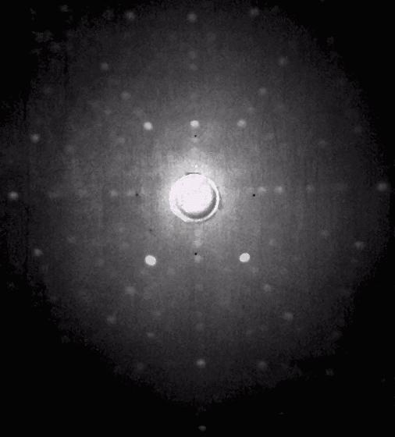
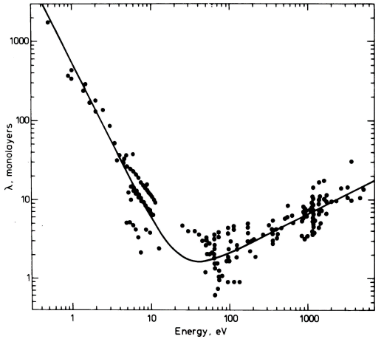
Typical Laue X-ray diffraction pattern
symmetry of the pattern
symmetry of the crystal
Laue X-ray diffraction
YAlO₃
c-axis normal to picture
Complementarity of the three types of radiation
X-ray diffraction
Electron diffraction
Neutron diffraction
Photon energies 10keV-100keV
Charged particle
Interaction with nuclei
large penetration depth
“strong” interaction
with matter
Improved efficiency
for light atoms
3D crystal structure
Inelastic scattering:
phonons
scattering by electron density
low penetration depth
Magnetic moment interacts
with moment of electrons
best results for
atoms with high Z
Study of: surfaces
thin films
Magnetic scattering:
Structure, magnons

Slide 4
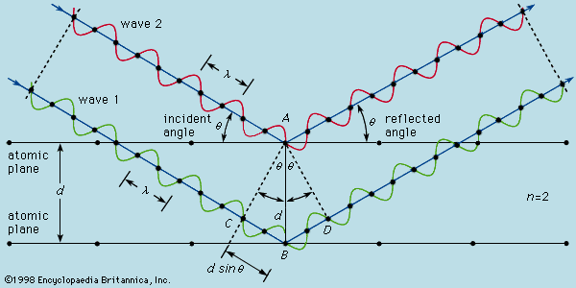
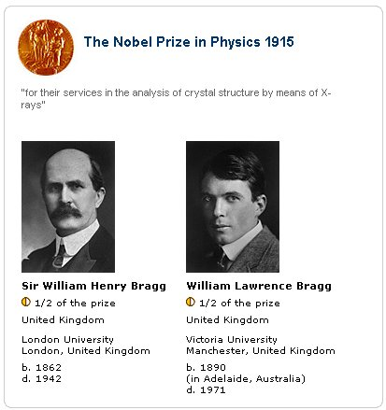
Bragg Diffraction Law
Law describing the necessary condition for diffraction
Applicable for photons, electrons and neutrons
Bragg’s law
Condition for efficient specular reflection
(click for java applet)
n: integer

Slide 5
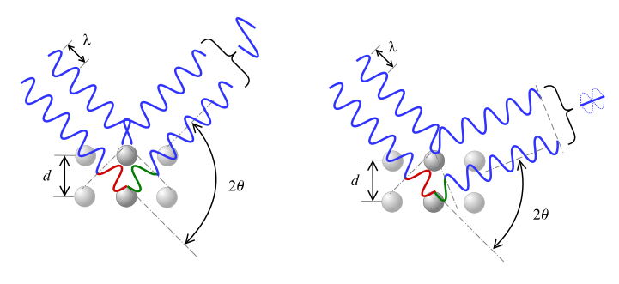
diagram of Bragg's Law angle of deviation 2 theta, interference can be constructive (left) or destructive (right)

Slide 6
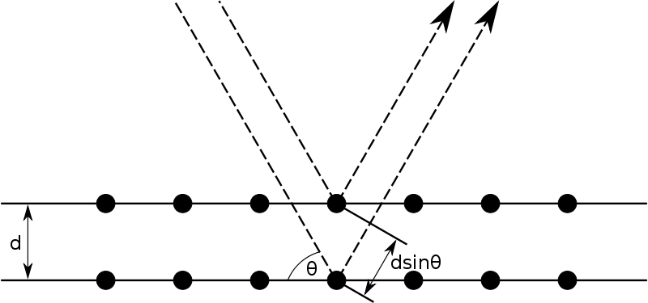
Bragg diffraction. Two beams with identical wavelength and phase approach a crystalline solid and are scattered off two different atoms within it. The lower beam traverses an extra length of 2dsinθ. Constructive interference occurs when this length is equal to an integer multiple of the wavelength of the radiation.

Slide 7
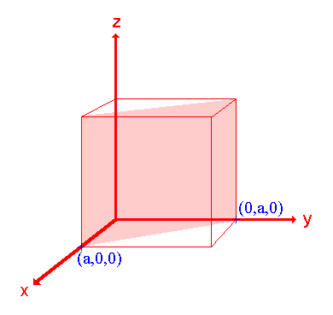
Spacing d_{hkl} between successive (hkl) planes
In cubic systems:
Top view
y
a
d₁₁₀
d_{hkl} for non cubic lattice
later in the framework
of the reciprocal lattice
x

Slide 8
structure factor
Bragg’s law necessary condition
Intensity of particular
(hkl) reflection
atomic form factor
General theory of Diffraction
P
R’-r
r
R’
B
R
X-ray source

Slide 9
Plane wave incoming at P
P
R’-r
r
R’
B
R
X-ray source
Scattered wave contribution from P
incoming at B
Electron density at P
Total scattering from the entire volume:

Slide 10
Diffraction experiment measures the intensity I of the scattered waves
where
is the scattering vector
Diffracted intensity is the square of the Fourier transform of the electron density
In crystals
is periodic
1D example

Slide 11
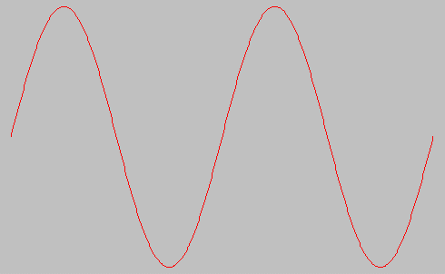
Fourier series expansion
2π periodic function decomposed into cos kx and sin kx
or
where

Slide 12
1dimensional case
3dimensional case
translational invariance of
with respect to lattice vector
with
Reciprocal lattice vectors

Slide 13
Remember:
Diffracted intensity is the square of the Fourier transform of the electron density
periodic electron density
with
(click for information about δ-functions)

Slide 14
is nothing but Bragg´s law
!
Scattering condition
The reciprocal lattice
decomposition into so far unknown basis vectors
with h, k, l integers

Slide 15
The basis vectors
of the reciprocal lattice are determined by:
These
fulfill the condition
holds, where

Slide 16
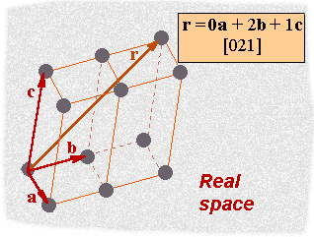
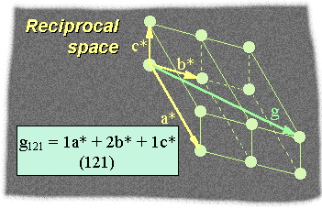
Examples for reciprocal lattices
3 dimensions

Slide 17
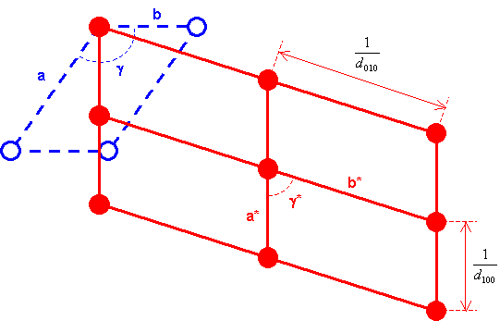
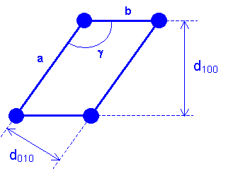
2 dimensions

Slide 18
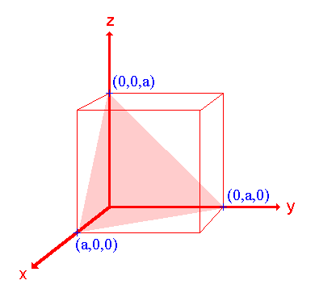
Important properties of the reciprocal lattice vectors
lies perpendicular to the lattice plane with Miller indices (hkl)
simple example for the (111) plane in the cubic structure
and
span the (111) lattice plane
vector
(111) plane
0

Slide 19
Distance d_{hkl} between lattice planes (hkl) related to
according to
d₁₁₁
G₁₁₁

Slide 20
Equivalence between the scattering condition
and Bragg´s law
-k₀
k₀
Ө
k
Ө
lattice plane (hkl)
Elastic scattering: k=k₀
1

Slide 21
Geometrical interpretation of the scattering condition
Ewald construction
reciprocal lattice
k
2Ө
G
k₀
(000)

Slide 22
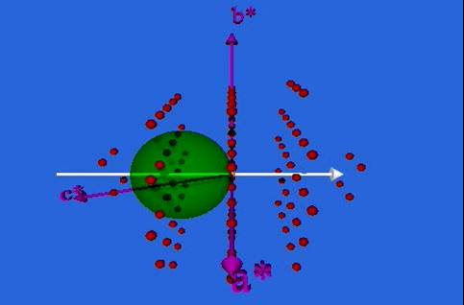
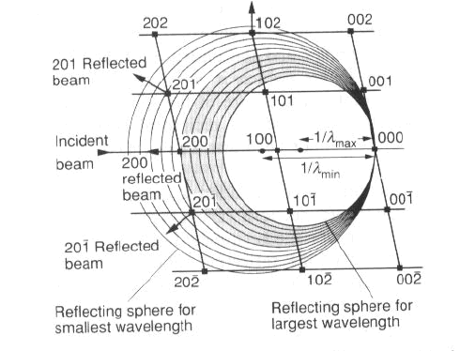
(click for animation)
Crystal in random orientation not necessarily reflection
rotation of the crystal
polychromatic radiation

Slide 23
Rotating crystal arrangement
determine unknown structure
Powder method / Debye Scherrer
incoming monochromatic beam
Precise measurement of
lattice constants

Slide 24
Laue method
transmission
Polychromatic X-rays
reflection
Orientation of crystal with known structure

Slide 25
The structure factor
Controls the actual intensity of the (hkl)-reflex
Scattering condition ( Bragg’s law )
necessary condition
Remember:
because crystal periodic
Fourier-coefficients

Slide 26
Majority of the electrons are centered in a small region around the atoms
core electrons
Scattering from valence electrons can be neglected
Atom in n-th unit cell is located at position
atomic scattering factor f_{α}
Structure factor

Slide 27
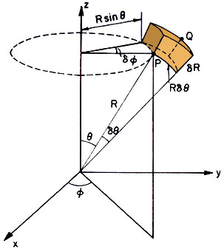
atomic scattering factor
Spherically symmetric
where
G , r’

Slide 28
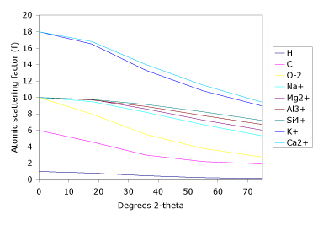
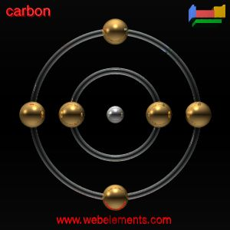
atomic scattering factor
Maximum at Ө=0 (forward scattering)
number of electrons/atom
(Click for calculations of
atomic scattering factors)

Slide 29
Structure factor of a lattice with basis
Structure factor of the bcc lattice:
Conventional cell contains two atoms at
r₂=(1/2,1/2,1/2)
r₁=(0,0,0)
Both atoms have the same atomic scattering factor f₁ = f₂ = f
Reciprocal unit cell:
cube with cell side of 2π/a

Slide 30
We observe e.g. diffraction peaks from (110), (200), (211) planes
but no peaks from (100), (111), (2,1,0) planes

Slide 31
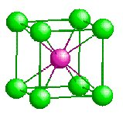
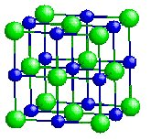
If f₁ = f₂
like CsI
peaks like (100), (111), (2,1,0) appear
Similar situation in the case of fcc KCl/KBr:
f(K⁺)=f(Cl⁻) = f(Br⁻)
KCl: Non-zero if all
indices even
KBr: all fcc-peaks
present
Shape and dimension of the unit cell can be deduced from Bragg peaks
Content of the unit cell (basis) determined from intensities of reflections

