Slide 1
Outlook:
After holidays: protein structure and function
(Project 2: 3D protein alignments)
Then: Systems biology, interactions of proteins with small and large molecules, protein-protein interactions, networks, graphs, network analysis
(Project 3: Mastering Cytoscape for network analysis)

Slide 2
Metagenome, microbiome, metagenomic analysis
In humans, only 1 in every 10 cells are ours, the others are bacterium cells,
The bacteria inside us contain 1000 times more genes than the human body.
About 0.5-1.5 kg of bacteria live with us
bacterial flora (the human microbiome),
http://commonfund.nih.gov/hmp/ the Human Microbiome Project
Environmental bacteria and viral species:
There are orders of magnitude more „species” than were believed before
Diabetes, obesity, autism(!) ceratin cancers are related to the microbiom

Slide 3
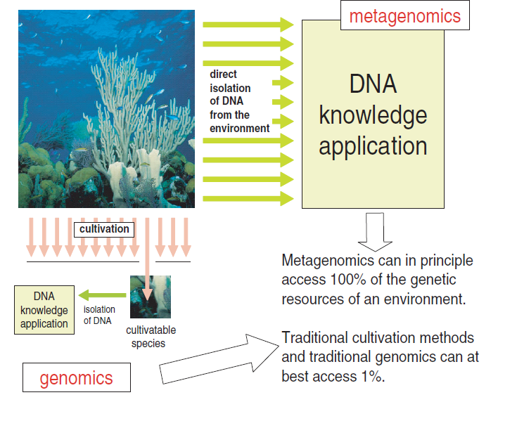

Slide 4
Viral genomes
The first look at seawater confirmed its huge diversity of viral assemblages: 65% of all the sequences examined from the first seawater viral libraries were novel and bore no significant similarity to any known genes in the databases.
Among sediment viral assemblages, even greater novelty was detected: more than 75% of the viral sequences recovered resembled nothing in the databases.

Slide 5
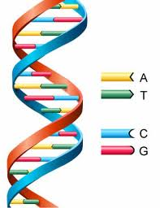
Size of the human genome: 3,1 Gbp
20 000 genes
100 000 proteins
Wheat genome: 17 Gbp

Slide 6
Genome sequencing techniques
Sanger sequencing: even large reads (>700 bp); cost: 400,000 $US / Gbp
454/Roche sequencing: 20,000 $US / Gbp
Illumina & Solexa sequencing: 50$US / Gbp

Slide 7
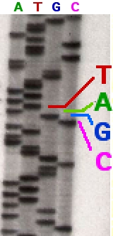
Sanger sequencing (one of the chain termination methods)
Frederick Sanger in 1977
"G" tube: all four dNTP's, ddGTP and DNA polymerase
"A" tube: all four dNTP's, ddATP and DNA polymerase
"T" tube: all four dNTP's, ddTTP and DNA polymerase
"C" tube: all four dNTP's, ddCTP and DNA polymerase
HOW? single-stranded DNA template, a DNA primer, a
DNA polymerase, normal deoxynucleotidetriphosphates
(dNTPs), and modified nucleotides (dideoxyNTPs) that
terminate DNA strand elongation.
The resulting DNA fragments are heat denatured
and separated by size using gel electrophoresis.

Slide 8
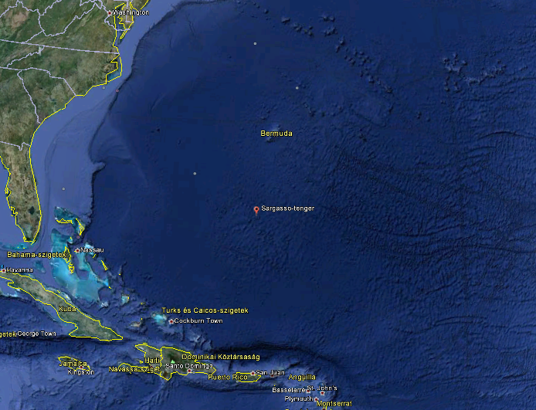
Sargasso sea biodiversity project
http://www.sciencemag.org/content/304/5667/66.full
De novo
multigenomic
assembly
Deposited in
genebank

Slide 9
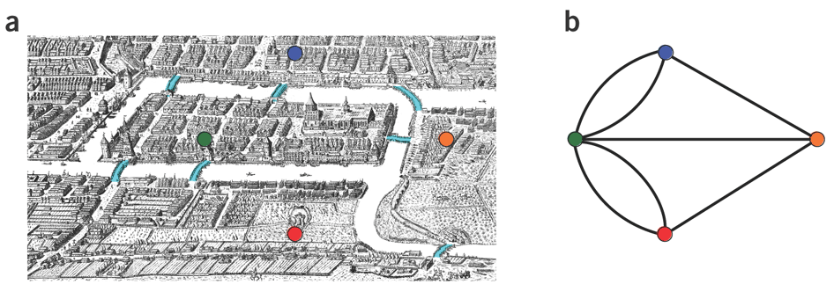
Graphs and sequence assembly
http://www.nature.com/nbt/journal/v29/n11/full/nbt.2023.html
Bridges of Königsberg problem 1735 Leonhard Euler

Slide 10
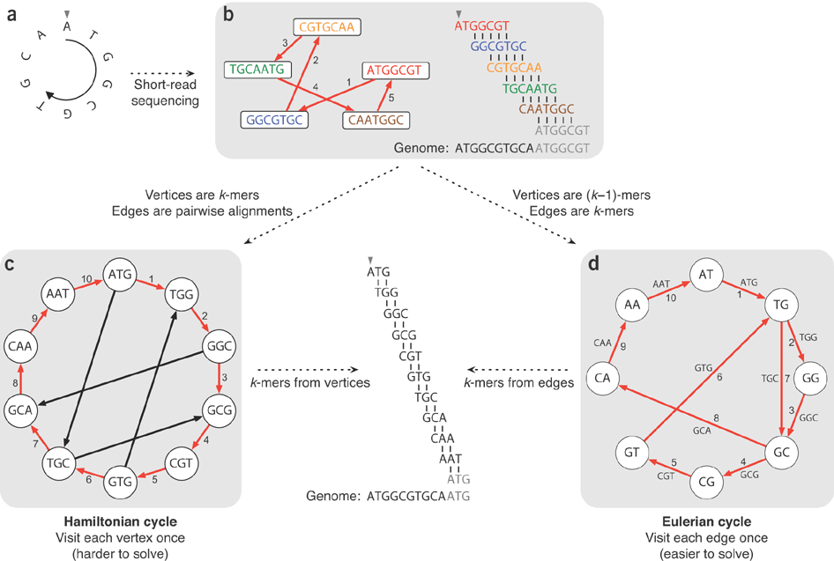
Sanger seq:
edge: if it overlaps
by at least 5
nucleotids

Slide 11
(a) An example small circular genome.
(b) In traditional Sanger sequencing algorithms, reads were represented as nodes in a graph, and edges represented alignments between reads. Walking along a Hamiltonian cycle by following the edges in numerical order allows one to reconstruct the circular genome by combining alignments between successive reads. At the end of the cycle, the sequence wraps around to the start of the genome. The repeated part of the sequence is grayed out in the alignment diagram.
(c) An alternative assembly technique first splits reads into all possible k-mers: with k = 3, ATGGCGT comprises ATG, TGG, GGC, GCG and CGT. Following a Hamiltonian cycle (indicated by red edges) allows one to reconstruct the genome by forming an alignment in which each successive k-mer (from successive nodes) is shifted by one position. This procedure recovers the genome but does not scale well to large graphs.
(d) Modern short-read assembly algorithms construct a de Bruijn graph by representing all k-mer prefixes and suffixes as nodes and then drawing edges that represent k-mers having a particular prefix and suffix. For example, the k-mer edge ATG has prefix AT and suffix TG. Finding an Eulerian cycle allows one to reconstruct the genome by forming an alignment in which each successive k-mer (from successive edges) is shifted by one position. This generates the same cyclic genome sequence without performing the computationally expensive task of finding a Hamiltonian cycle.

Slide 12
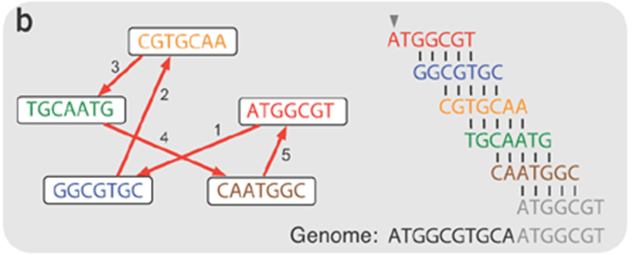
This method, however, is not as easy to implement as it might seem. Imagine attempting to create a similar graph for a single run of an Illumina (San Diego) sequencer that generates many reads. A million (10⁶) reads will require a trillion (10¹²) pairwise alignments. A billion (10⁹) reads necessitate a quintillion (10¹⁸) alignments.
What's more, there is no known efficient algorithm for finding a Hamiltonian cycle.

Slide 13
Origin of de Bruijn graphs
In 1946, the Dutch mathematician Nicolaas de Bruijn became interested in the 'superstring problem'12: find a shortest circular 'superstring' that contains all possible 'substrings' of length k (k-mers) over a given alphabet. There exist n^{k} k-mers in an alphabet containing n symbols: for example, given the alphabet comprising A, T, G and C, there are 4³ = 64 trinucleotides. If our alphabet is instead 0 and 1, then all possible 3-mers are simply given by all eight 3-digit binary numbers: 000, 001, 010, 011, 100, 101, 110, 111. The circular superstring 0001110100 not only contains all 3-mers but also is as short as possible, as it contains each 3-mer exactly once. But how can one construct such a superstring for all k-mers in the case of an arbitrary value of k and an arbitrary alphabet? De Bruijn answered this question by borrowing Euler's solution of the Bridges of Königsberg problem.
Briefly, construct a graph B (the original graph called a de Bruijn graph) for which every possible (k − 1)-mer is assigned to a node; connect one (k − 1)-mer by a directed edge to a second (k − 1)-mer if there is some k-mer whose prefix is the former and whose suffix is the latter (Fig. 2). Edges of the de Bruijn graph represent all possible k-mers, and thus an Eulerian cycle in B represents a shortest (cyclic) superstring that contains each k-mer exactly once. By checking that the indegree and outdegree of every node in B equals the size of the alphabet, we can verify that B contains an Eulerian cycle. In turn, we can construct an Eulerian cycle using Euler's algorithm, therefore solving the superstring problem. It should now be apparent why the 'de Bruijn graph' construction described in the main text, which does not use all possible k-mers as edges but rather only those generated from our reads, is also named in honor of de Bruijn.

Slide 14
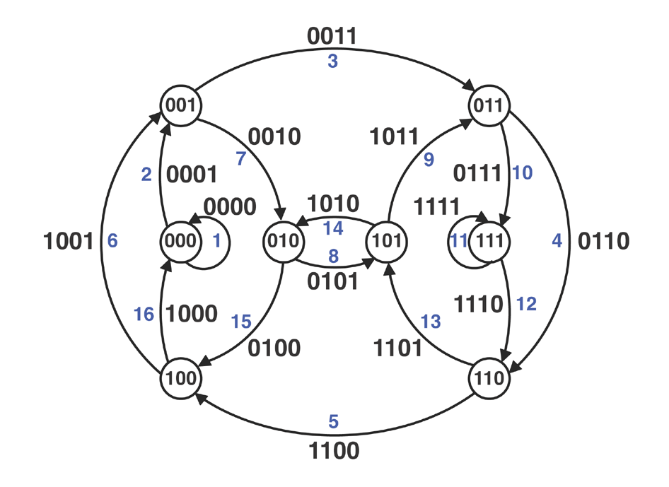

Slide 15
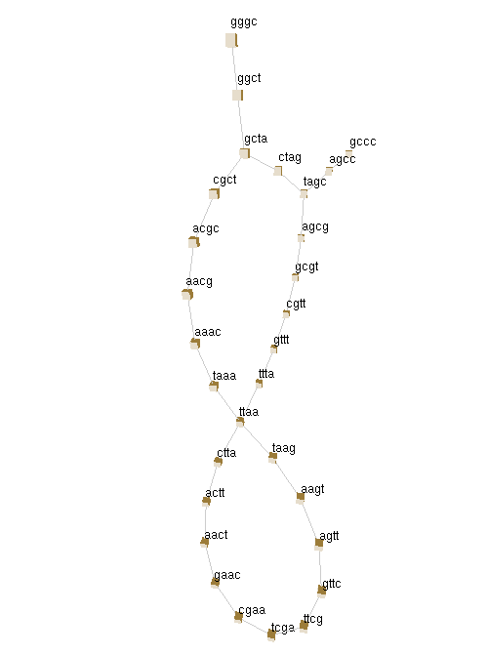
The idea: instead of vertices, edges represent k-mers- here tetramers
gggctagcgtttaagttcga

