Slide 1
BLAST:
Basic local alignment
search tool

Slide 2
Copyright notice
Many of the images in this powerpoint presentation
are from Bioinformatics and Functional Genomics
by Jonathan Pevsner (ISBN 0-471-21004-8).
Copyright © 2003 by John Wiley & Sons, Inc.
These images and materials may not be used
without permission from the publisher. We welcome
instructors to use these powerpoints for educational
purposes, but please acknowledge the source.
The book has a homepage at http://www.bioinfbook.org
including hyperlinks to the book chapters.

Slide 3
Outline of today’s lecture
Summary of key points about pairwise alignment
Introduction to BLAST: practical guide to database searching
The BLAST algorithm
BLAST search strategies

Slide 4
BLAST
BLAST (Basic Local Alignment Search Tool)
allows rapid sequence comparison of a query
sequence against a database.
The BLAST algorithm is fast, not exactly accurate,
and web-accessible.

Slide 5
Why use BLAST?
BLAST searching is fundamental to understanding
the relations of any favorite query sequence
to other known proteins or DNA sequences.
Applications include
discovering new genes or proteins
discovering variants of genes or proteins
exploring protein structure and function

Slide 6
Four components to a BLAST search
(1) Choose the sequence (query)
(2) Select the BLAST program
(3) Choose the database to search
(4) Choose optional parameters
Then click “BLAST”

Slide 7
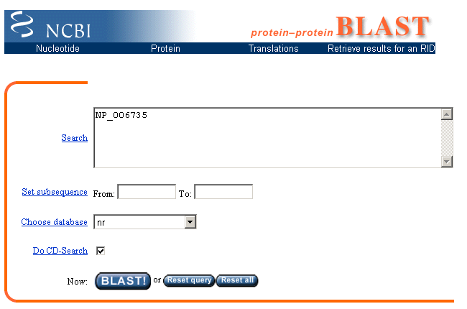

Slide 8
Step 1: Choose your sequence
Sequence can be input in FASTA format or as accession number
page 89

Slide 9
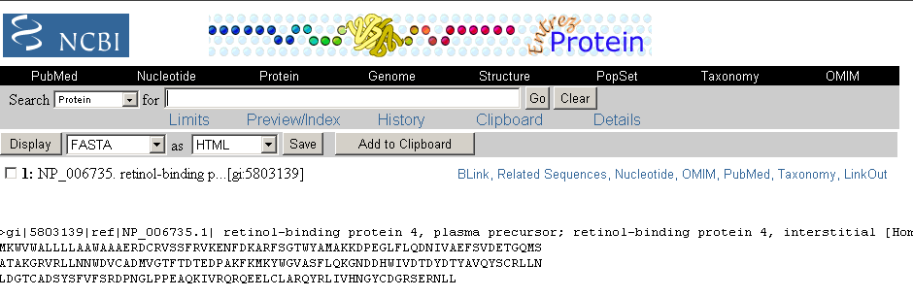
Example of the FASTA format for a BLAST query

Slide 10
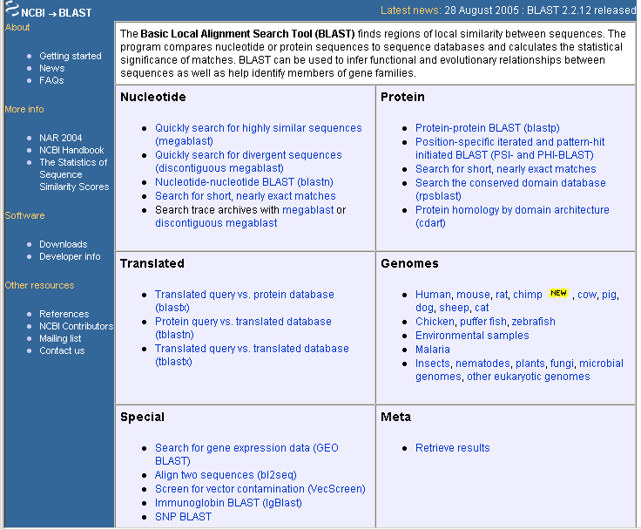
Step 2: Choose the BLAST program

Slide 11
Step 2: Choose the BLAST program
blastn (nucleotide BLAST)
blastp (protein BLAST)
tblastn (translated BLAST)
blastx (translated BLAST)
tblastx (translated BLAST)

Slide 12
Choose the BLAST program
Program Input Database
1
blastn DNA DNA
1
blastp protein protein
6
blastx DNA protein
6
tblastn protein DNA
36
tblastx DNA DNA

Slide 13
DNA potentially encodes six proteins
5’ CAT CAA
5’ ATC AAC
5’ TCA ACT
5’ CATCAACTACAACTCCAAAGACACCCTTACACATCAACAAACCTACCCAC 3’
3’ GTAGTTGATGTTGAGGTTTCTGTGGGAATGTGTAGTTGTTTGGATGGGTG 5’
5’ GTG GGT
5’ TGG GTA
5’ GGG TAG

Slide 14
Step 3: choose the database
nr = non-redundant (most general database)
dbest = database of expressed sequence tags
dbsts = database of sequence tag sites
gss = genomic survey sequences
htgs = high throughput genomic sequence

Slide 15
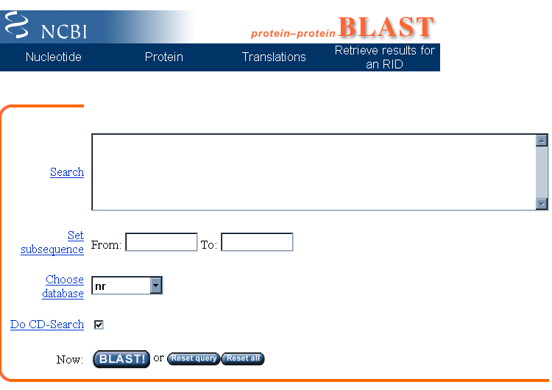
Step 4a: Select optional search parameters
CD search

Slide 16
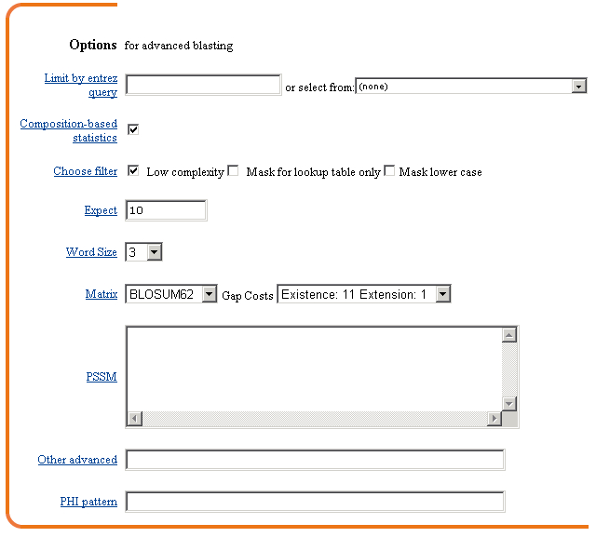
Step 4a: Select optional search parameters
Entrez!
Filter
Expect
Word size
organism
Scoring matrix

Slide 17
BLAST: optional parameters
You can...
• choose the organism to search
• turn filtering on/off
• change the substitution matrix
• change the expect (e) value
• change the word size
• change the output format
page 93

Slide 18
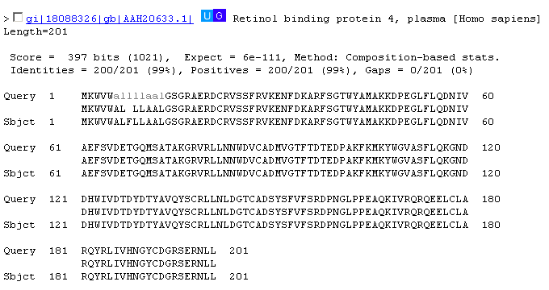
filtering

Slide 19
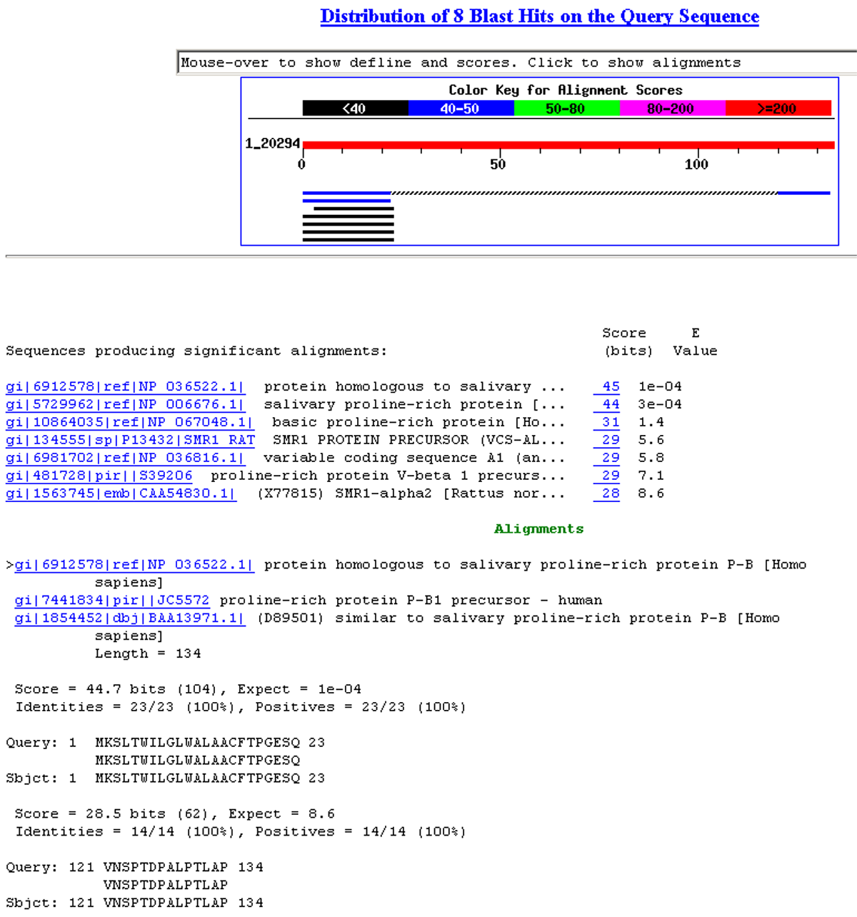
Fig. 4.7
page 95

Slide 20
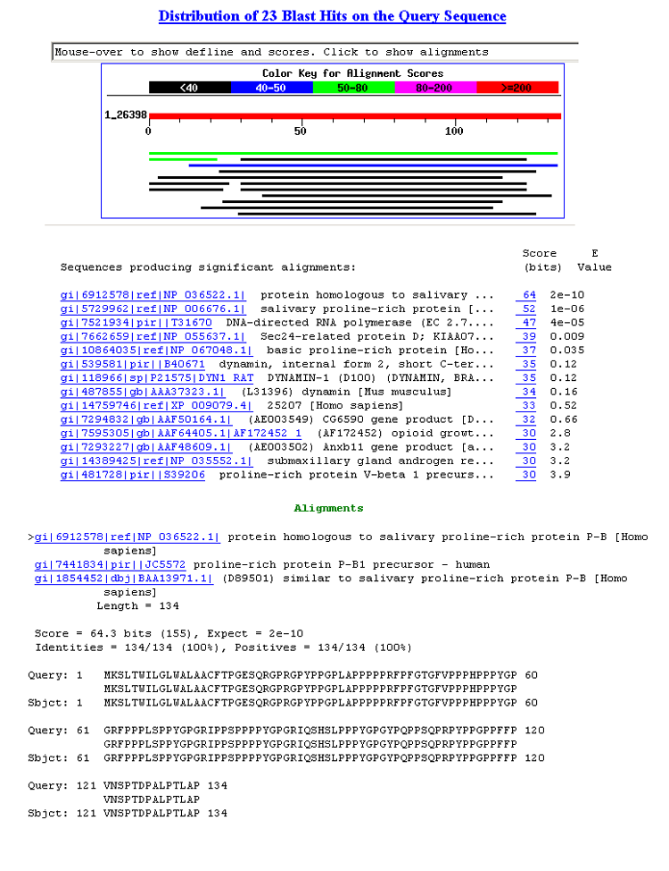

Slide 21
Step 4b: optional formatting parameters
Alignment view
Descriptions
Alignments
page 97

Slide 22
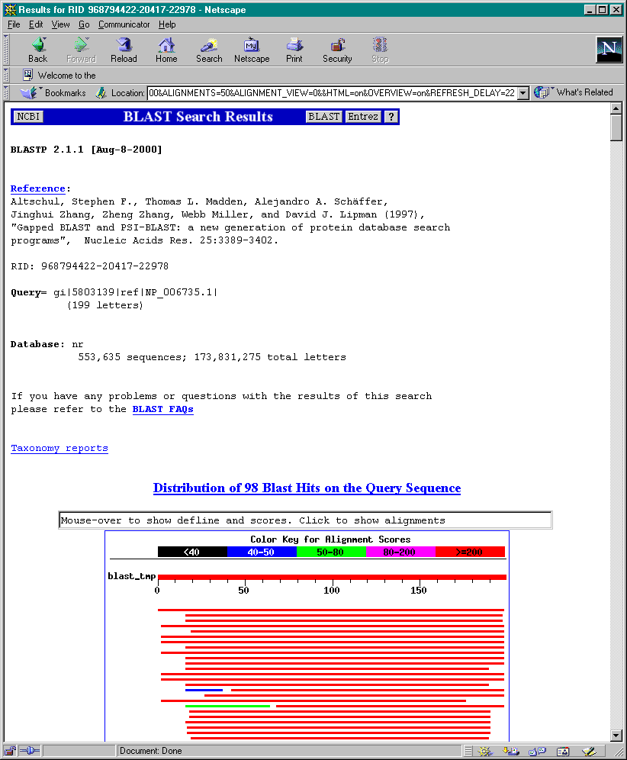
program
query
database
taxonomy

Slide 23
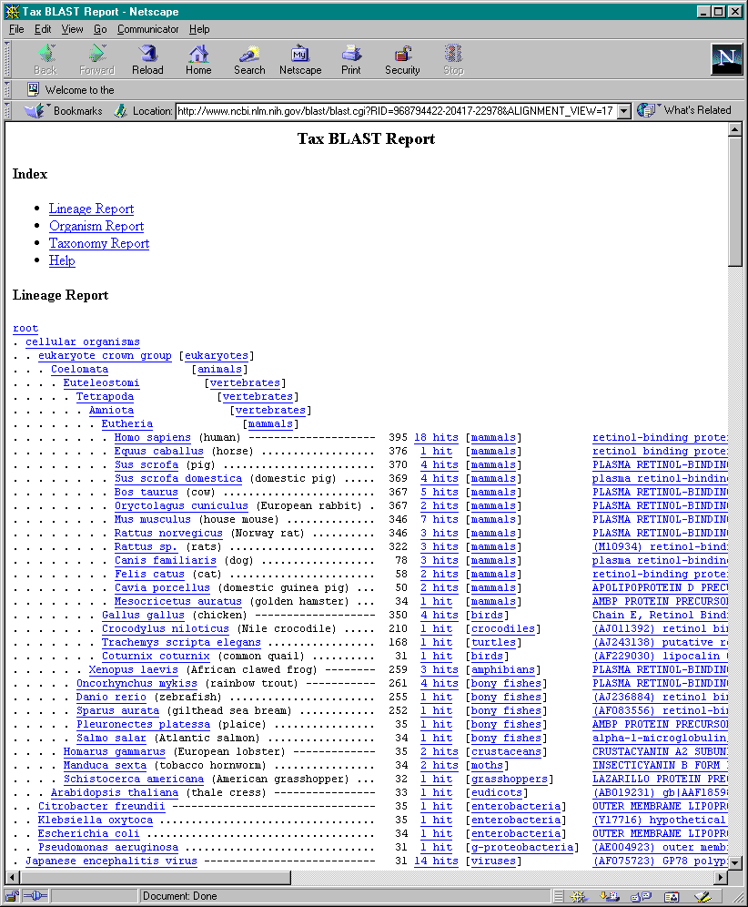
taxonomy

Slide 24
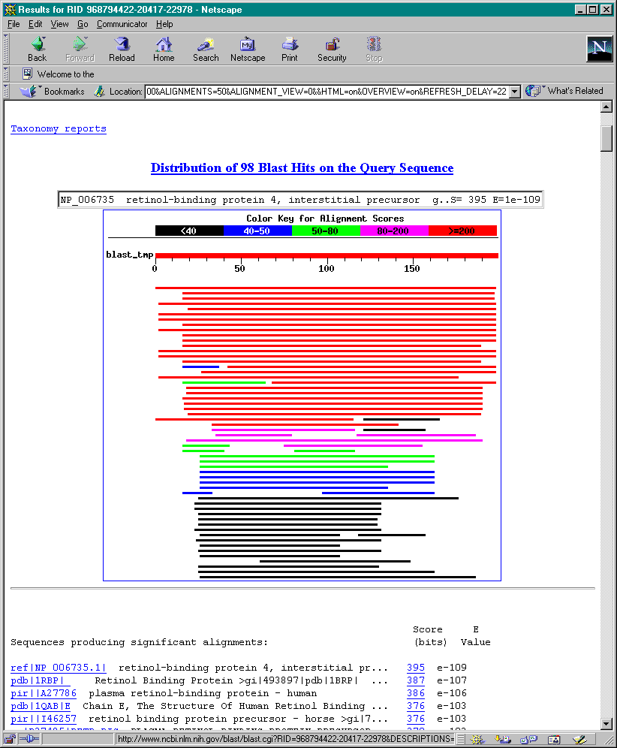
page 99

Slide 25
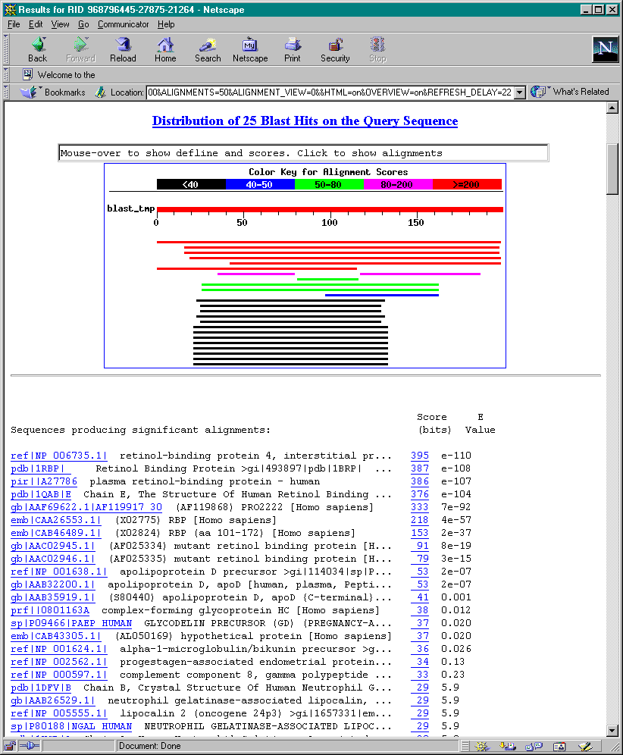
High scores
low e values
Cut-off:
.05?
10⁻¹⁰?

Slide 26
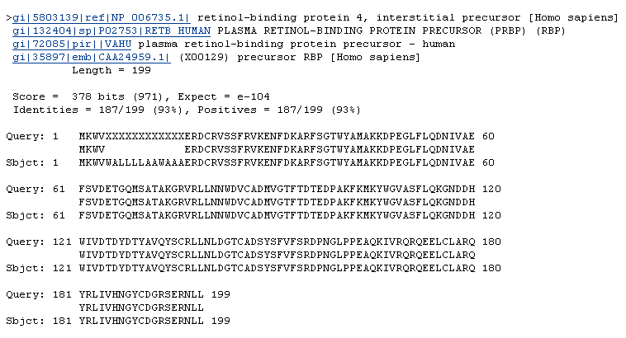

Slide 27
BLAST: background on sequence alignment
There are two main approaches to sequence
alignment:
[1] Global alignment (Needleman & Wunsch 1970)
using dynamic programming to find optimal
alignments between two sequences.
(Although the alignments are optimal, the
search is not exhaustive.) Gaps are permitted
in the alignments, and the total lengths of both
sequences are aligned (hence “global”).

Slide 28
BLAST: background on sequence alignment
[2] The second approach is local sequence
alignment (Smith & Waterman, 1980). The
alignment may contain just a portion of either
sequence, and is appropriate for finding matched
domains between sequences. S-W is guaranteed
to find optimal alignments, but it is
computationally expensive (requires O(n²) time).
BLAST and FASTA are heuristic approximations to
local alignment. Each requires only O(n) time;
they examine only part of the search space.

Slide 29
How the original BLAST algorithm works:
three phases
Phase 1: compile a list of word pairs (w=3)
above threshold T
Example: for a human RBP query
…FSGTWYA… (query word is in yellow)
A list of words (w=3) is:
FSG SGT GTW TWY WYA
YSG TGT ATW SWY WFA
FTG SVT GSW TWF WYS

Slide 30
Phase 1: compile a list of words (w=3)
GTW 6,5,11 22
neighborhood ASW 6,1,11 18
word hits ATW 0,5,11 16
> threshold NTW 0,5,11 16
GTY 6,5,2 13
GNW 10
neighborhood GAW 9
word hits
< below threshold
(T=11)

Slide 31
Pairwise alignment scores
are determined using a
scoring matrix such as
Blosum62

Slide 32
How a BLAST search works: 3 phases
Phase 2:
Scan the database for entries that match the compiled list.
This is fast and relatively easy.

Slide 33
How a BLAST search works: 3 phases
Phase 3: when you manage to find a hit
(i.e. a match between a “word” and a database
entry), extend the hit in either direction.
Keep track of the score (use a scoring matrix)
Stop when the score drops below some cutoff.
KENFDKARFSGTWYAMAKKDPEG 50 RBP (query)
MKGLDIQKVAGTWYSLAMAASD. 44 lactoglobulin (hit)
extend
extend
Hit!

Slide 34
How a BLAST search works: 3 phases
Phase 3:
In the original (1990) implementation of BLAST,
hits were extended in either direction.
In a 1997 refinement of BLAST, two independent
hits are required. The hits must occur in close
proximity to each other. With this modification,
only one seventh as many extensions occur,
greatly speeding the time required for a search.

Slide 35
How a BLAST search works: threshold
You can modify the threshold parameter.
The default value for blastp is 11.
To change it, enter “-f 16” or “-f 5” in the
advanced options.

Slide 36
How to interpret a BLAST search: expected value
It is important to assess the statistical significance
of search results.
For global alignments, the statistics are poorly understood.
For local alignments (including BLAST search results),
the statistics are well understood. The scores follow
an extreme value distribution (EVD) rather than a
normal distribution.

Slide 37
How to interpret BLAST: E values and p values
The expect value E is the number of alignments
with scores greater than or equal to score S
that are expected to occur by chance in a
database search. A p value is a different way of
representing the significance of an alignment.
p = 1 - e^{-Ε}

Slide 38
How to interpret BLAST: E values and p values
Very small E values are very similar to p values.
E values of about 1 to 10 are far easier to interpret
than corresponding p values.
E p
10 0.99995460
5 0.99326205
2 0.86466472
1 0.63212056
0.1 0.09516258 (about 0.1)
0.05 0.04877058 (about 0.05)
0.001 0.00099950 (about 0.001)
0.0001 0.0001000

