Slide 1
Sequence search and alignment algorithms

Slide 2
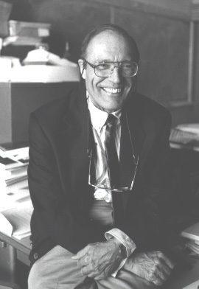
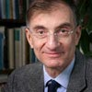
Mathematics-Biology
Gian-Carlo Rota, 1932-1999:
“The lack of real contact between mathematics
and biology is either a tragedy, a scandal, or a
challenge, it is hard to decide which”
Joel E. Cohen:
“Mathematics Is Biology's Next Microscope, Only Better;
Biology Is Mathematics' Next Physics, Only Better”

Slide 3
A, species-count and abundance
In humans, only 1 in every 10 cells are ours, the others are bacterium cells,
About 0.5-1.5 kg of bacteria live with us
bacterial flora (the human microbiome),
http://commonfund.nih.gov/hmp/ the Human Microbiome Project
Environmental bacteria and viral species:
There are orders of magnitude more „species” than were believed before

Slide 4
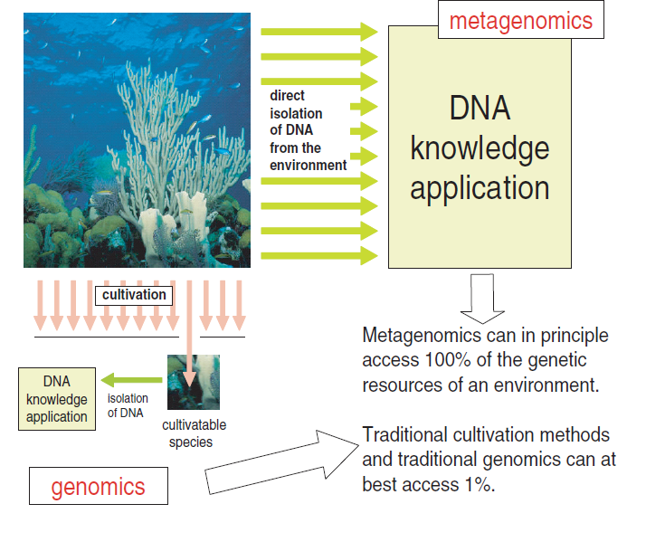

Slide 5
Viral genomes
The first look at seawater confirmed its huge diversity of viral assemblages: 65% of all the sequences examined from the first seawater viral libraries were novel and bore no significant similarity to any known genes in the databases.
Among sediment viral assemblages, even greater novelty was detected: more than 75% of the viral sequences recovered resembled nothing in the databases.

Slide 6
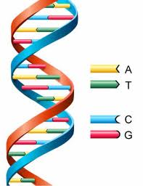
Size of the human genome: 3,1 Gbp
20 000 genes
100 000 proteins
Wheat genome: 17 Gbp

Slide 7
Genome sequencing techniques
Sanger sequencing: even large reads (>700 bp); cost: 400,000 $US / Gbp
454/Roche sequencing: 20,000 $US / Gbp
Illumina & Solexa sequencing: 50$US / Gbp

Slide 8
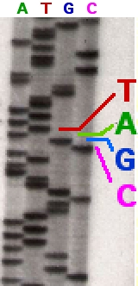
Sanger sequencing (one of the chain termination methods)
Frederick Sanger in 1977
"G" tube: all four dNTP's, ddGTP and DNA polymerase
"A" tube: all four dNTP's, ddATP and DNA polymerase
"T" tube: all four dNTP's, ddTTP and DNA polymerase
"C" tube: all four dNTP's, ddCTP and DNA polymerase
HOW? single-stranded DNA template, a DNA primer, a
DNA polymerase, normal deoxynucleotidetriphosphates
(dNTPs), and modified nucleotides (dideoxyNTPs) that
terminate DNA strand elongation.
The resulting DNA fragments are heat denatured
and separated by size using gel electrophoresis.

Slide 9
Main tasks:
sequence assembly re-sequencing or de novo
sub-sequence search
sequence alignment

Slide 10
Simple sequence search
Search Text
n
m
a
a
a
b
a
a
b
a
a
a
b
a
a
b
a
a
a
Complexity: O(nm)

Slide 12
Knuth-Morris-Pratt
KMP algorithm. [over binary alphabet]
Build DFA from pattern.
Run DFA on text.
Search Text
a
a
a
b
a
a
b
a
a
a
b
a
a
b
a
a
a
b
a
b
a
a
b
a
a
a
0
1
2
3
4
5
6
b
accept state
b
b

Slide 13
Knuth-Morris-Pratt
KMP algorithm. [over binary alphabet]
Build DFA from pattern.
Run DFA on text.
Search Text
a
a
a
b
a
a
b
a
a
a
b
a
a
b
a
a
a
b
a
b
a
a
b
a
a
a
0
1
2
3
4
5
6
b
accept state
b
b

Slide 14
Knuth-Morris-Pratt
KMP algorithm. [over binary alphabet]
Build DFA from pattern.
Run DFA on text.
Search Text
a
a
a
b
a
a
b
a
a
a
b
a
a
b
a
a
a
b
a
b
a
a
b
a
a
a
0
1
2
3
4
5
6
b
accept state
b
b

Slide 15
Knuth-Morris-Pratt
KMP algorithm. [over binary alphabet]
Build DFA from pattern.
Run DFA on text.
Search Text
a
a
a
b
a
a
b
a
a
a
b
a
a
b
a
a
a
a
a
b
a
a
a
b
a
b
a
a
b
a
a
a
0
1
2
3
4
5
6
b
accept state
b
b

Slide 16
Knuth-Morris-Pratt
KMP algorithm. [over binary alphabet]
Build DFA from pattern.
Run DFA on text.
Search Text
a
a
a
b
a
a
b
a
a
a
b
a
a
b
a
a
a
a
a
b
a
a
a
b
a
b
a
a
b
a
a
a
0
1
2
3
4
5
6
b
accept state
b
b

Slide 17
Knuth-Morris-Pratt
KMP algorithm. [over binary alphabet]
Build DFA from pattern.
Run DFA on text.
Search Text
a
a
a
b
a
a
b
a
a
a
b
a
a
b
a
a
a
a
a
b
a
a
a
b
a
b
a
a
b
a
a
a
0
1
2
3
4
5
6
b
accept state
b
b

Slide 18
Knuth-Morris-Pratt
KMP algorithm. [over binary alphabet]
Build DFA from pattern.
Run DFA on text.
Search Text
a
a
a
b
a
a
b
a
a
a
b
a
a
b
a
a
a
a
a
b
a
a
a
b
a
b
a
a
b
a
a
a
0
1
2
3
4
5
6
b
accept state
b
b

Slide 19
Knuth-Morris-Pratt
KMP algorithm. [over binary alphabet]
Build DFA from pattern.
Run DFA on text.
Search Text
a
a
a
b
a
a
b
a
a
a
b
a
a
b
a
a
a
a
a
b
a
a
a
a
a
b
a
a
a
b
a
b
a
a
b
a
a
a
0
1
2
3
4
5
6
b
accept state
b
b

Slide 20
Knuth-Morris-Pratt
KMP algorithm. [over binary alphabet]
Build DFA from pattern.
Run DFA on text.
Search Text
a
a
a
b
a
a
b
a
a
a
b
a
a
b
a
a
a
a
a
b
a
a
a
a
a
b
a
a
a
b
a
b
a
a
b
a
a
a
0
1
2
3
4
5
6
b
accept state
b
b

Slide 21
Knuth-Morris-Pratt
KMP algorithm. [over binary alphabet]
Build DFA from pattern.
Run DFA on text.
Search Text
a
a
a
b
a
a
b
a
a
a
b
a
a
b
a
a
a
a
a
b
a
a
a
a
a
b
a
a
a
b
a
b
a
a
b
a
a
a
0
1
2
3
4
5
6
b
accept state
b
b

Slide 22
Knuth-Morris-Pratt
KMP algorithm. [over binary alphabet]
Build DFA from pattern.
Run DFA on text.
Search Text
a
a
a
b
a
a
b
a
a
a
b
a
a
b
a
a
a
a
a
b
a
a
a
a
a
b
a
a
a
b
a
b
a
a
b
a
a
a
0
1
2
3
4
5
6
b
accept state
b
b

Slide 23
Knuth-Morris-Pratt
KMP algorithm. [over binary alphabet]
Build DFA from pattern.
Run DFA on text.
Search Text
a
a
a
b
a
a
b
a
a
a
b
a
a
b
a
a
a
a
a
b
a
a
a
a
a
b
a
a
a
b
a
b
a
a
b
a
a
a
0
1
2
3
4
5
6
b
accept state
b
b

Slide 24
Complexity
Constructing DFA: O(m)
Running DFA on text: O(n)
That is, O(n+m)

